Slide 1
Happy New Year!
Wow, how is it already nearing the end of January?? With holidays, illnesses, freezing weather and snow it seems the month of January flew by in a blur.
There are a few important January and February items coming up I would like to remind you of. FIrst being the ALberta Education Assurance Surveys which will be sent out to parents in grade 4,7 and 10. This data is used to help the school and school division plan for next year and we appreciate your feedback.
The process for replacing me as principal has started with a feedback survey for staff and our parent council and the posting of the position.
Report cards will come home February 2nd. Until that time you will see changes occurring in PowerSchool as teachers complete assessments and add comments.
Our students are curling, swimming lessons are coming up soon so please complete and return forms and money at your earliest convenience. Should you require assistance with finances please call the office.
The weather is still cold and unpredictable so please ensure your child has appropriate outerwear as we do continue outside activities when possible.
Have a wonderful month, enjoy the February break and stay warm and safe as we hope winter makes way for spring.
Mrs. Leana Howard
Principal of Elnora School
“Learning For Life”
NEWSLETTER
January & February 2024
Inside the Issue:
Principal’s Message
January Calendar
February Calendar
Reminders
Swim Information
Curling information
Community Closet info - Winter clothing
Donut Days information
Donut Day order form and information
Pink shirt day poster
Photos
Important Dates:
Jan 8 - Back to school
Jan 9 - Dairy Queen hot lunch
Jan 15 - Pj Day
Jan 17 - BP’s orders are due
Jan 17 - Curling Gr 5-8, 1-3pm
Jan 18 - PAC meeting @ school 330pm
Jan 19 - Foodtastic Friday
Jan 22 - Pj Day
Jan 23 - BP’s hot lunch
Jan 24 - Curling Gr 5-8, 1-3pm
Jan 29 - Pj Day
Jan 31 - PD day no school for students
~~~~~~~~~~~~~~~~~~~~~~~~~~~
Feb 2 - Report Cards
Feb 2 - Deadline for Candygrams
Feb 7 - Curling Gr 5 / 8 from 1-3pm
Feb 9- PD day - no school for students
Feb 13 - Pink shirt day - in support of anti bullying
Feb 14 - Valentines Day
Feb 14 - Curling Gr 5 / 8 from 1-3pm
Feb 19 - Family Day
Feb 19 - Feb 23 - School break
Feb 26 - Swim lessons Gr 3,4,7,8
Feb 27 - Swim lessons K,1,2,5,6
Feb 28 - Swim lessons Gr 3,4,7,8
Feb 29 - Swim lessons K,1,2,5,6
Feb 29 - Leap day
Principal’s Message
Find Us
www.elnoraschool.ca
Facebook: @elnoraschool
Instagram: @elnoraeagles
Join the Elnora Parent Council Facebook Group

Slide 2
January 2024
M
T
W
Th
F
 | 1 | 2 | 3 | 4 | 5 | 6
7 | 8 First day back at school | 9 Hot Lunch Day | 10 | 11 PAC meeting 3:30 @ School | 12 RED DAY SCHOOL CLOSED DUE TO WEATHER | 13
14 | 15 RED DAY SCHOOL CLOSED DUE TO WEATHER | 16 | 17 **Boston Pizza orders due** Gr 5-8 Curling from 1-3pm | 18 | 19 Foodtastic Friday | 20
21 | 22 Kinder Monday Pj Day | 23 Boston Pizza Hot Lunch | 24 Gr 5-8 curling from 1-3pm | 25 | 26 **Donut order forms due with payment ** | 27
28 | 29 Pj day | 30 Donut Day | 31 PD day no school for students

Slide 3
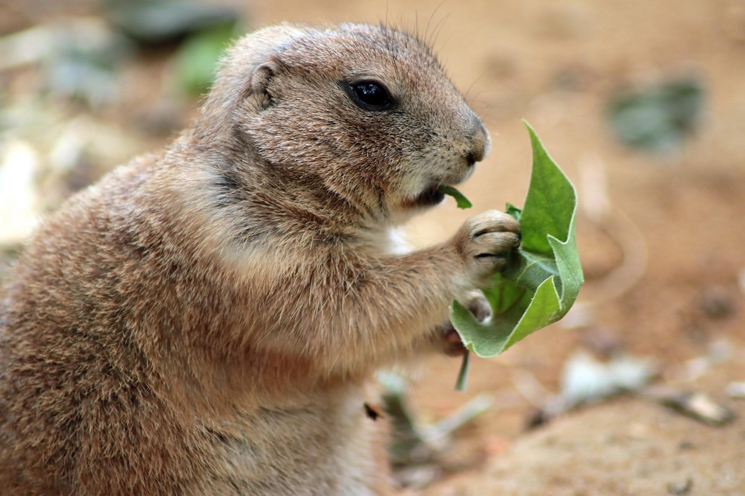
February 2024
M
T
W
Th
F
 |  |  |  | 1 | 2 Report Cards Deadline for Candygrams Groundhog Day | 3
4 | 5 | 6 **Edo Japan orders due** | 7 Grade 5-8 curling from 1-3pm | 8 **Donut orders due with payment** | 9 PD DAY no school for students | 10
11 | 12 Kinder Monday | 13 Pink Shirt day - in support of anti-bullying Edo Japan hot lunch | 14 Grade 5-8 curling from 1-3pm | 15 Donut Day | 16 | 17
18 | 19 February Family day | 20 Break | 21 No School **Boston Pizza orders due** | 22 Teachers | 23 Convention | 24
25 | 26 Swim lessons Gr ¾ & ⅞ | 27 Swim lessons K, ½ & ⅚ Boston Pizza hot lunch | 28 Swim lessons Gr ¾ & ⅞ | 29 Swim lessons K, ½ & ⅚

Slide 4
Reminders for January
Our staff would like to remind you that with the cold weather approaching to make sure your kiddos have warm winter gear on. We still do outside recess until the weather permits us to stay inside (-20ºC), so please try and have their stuff in their backpacks if possible. If anyone is in need of some items for their kids, please call the office and talk to Miss K!
As the cold winter sets in this month please watch your emails, texts and phone calls from our school division to determine if school is closed or buses are not running.
We will do our best to keep you all up to date with weather changes and school closings.
Thank you for remembering that we are a Nut Free School. We have some students that are very allergic to peanuts and other nuts so please do not send food containing nuts to school. We want to keep everyone safe and healthy.
Gym wear is required for our grade 6-8 students. Please make sure your child has extra gym clothes with them. We are running out of the extra clothes that we have here, and we really want them to be able to participate in the activities planned for their gym classes. When they do not have the appropriate clothing, it stops them from being able to participate. Just a friendly reminder to please make sure they have this with them!

Slide 5
January 15th, 2024
Dear Parents and Caregivers,
Elnora School is pleased to once again offer swim lessons to our students in grades K-8. The lessons will take place at the Three Hills Aquatic Center beginning on February 26th and ending on March 15th. Students in Kindergarten, grades 1-2 and 5-6 will have lessons on Tuesdays and Thursdays. Grades 3-4 and 7-8 lessons will be on Mondays and Wednesdays.
We will be transported by Chinook’s Edge School Division. We leave at 9:45 am in order to be ready to swim by 10:30 am. We are back at the school by 12:15 pm each day.
Swim lesson dates:
Kindergarten, Grade 1-2, 5-6
February 27, 29, March 5, 7, 12, 14
Grades 3-4, 7-8
February 26, 28, March 4, 6. 11. 13
Friday’s are set aside for make up lessons in case of inclement weather.
**Please send swimsuit, towel and goggles (If desired) with your child on their appropriate days. Also there is no purchases allowed from the vending machines, so no money is needed. **
Cost of swim lessons is $50 which helps cover the cost of transport and fees. We have some very generous donations in the community that help to bring this cost down each year!
Please check your email and online fees to fill out the form and pay for your child.
If you have any questions please call the School.
Thank you from the Elnora School Staff.

Slide 6
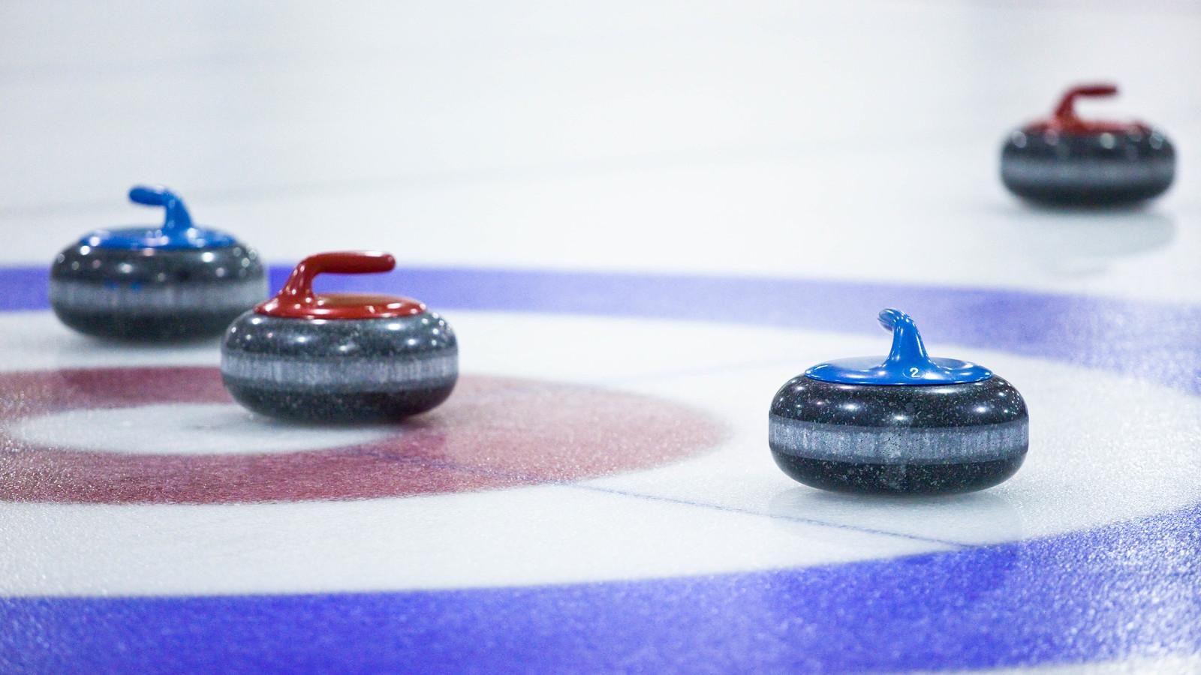
Curling dates and information
Dates for Grades 5-8
Jan 17 from 1-3pm
Jan 24 from 1-3pm
Feb 7 from 1-3
Feb 14 from 1-3
**Please ensure your child is coming to school with winter gear, a helmet and any curling items they may have on these days**
No helmet, No curling
Ski pants and warm winter gear is needed as we walk from the school to the rink and we want to keep the kids safe and warm.
Please ensure they have what they need to be successful.
Thank you to Elnora Ag Society for allowing us access to the curling rink.
A big thank you to Irv Peterson for volunteering his time to help the kids learn this sport. We appreciate what this community and people in it do for all of us here at the Elnora School!

Slide 7
This great place is totally free! If you or your child need winter or other clothing please stop in and get what you need.

Slide 8
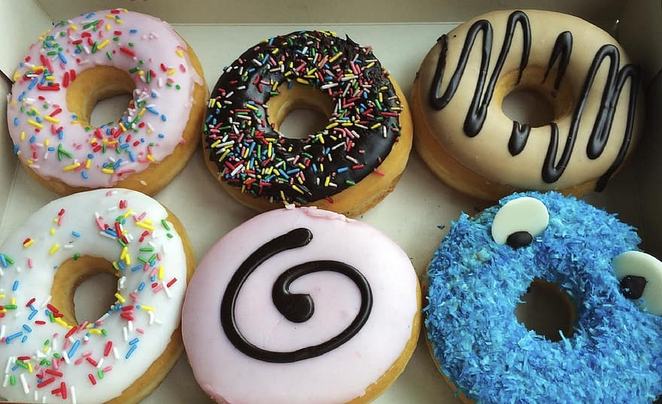
We are really excited to bring in Donut Days at our school. Forms will be sent home with your child with the dates and deadlines for orders. This will also include what options your child wants!
Thank you to Oops Grocery and The Grocery Barn for making this available to our school.

Slide 9
Donut Day order for students
Donut Day order form
Date: January 30th, 2024
Name of Student(s):
Grade of Student(s):
Donut Options Quantity Total
Long John Sprinkles
Glazed Plain
Cake Donut
Boston Cream
Raspberry Sugar
Bavarian Cream
**Price is $1.50 per donut. We will do this as cash, so please send the money and a form with your child on the due dates.**
Thank you!

Slide 10
Pink Shirt Day February 13th. Please wear a pink shirt in support of anti-bullying!

Slide 11
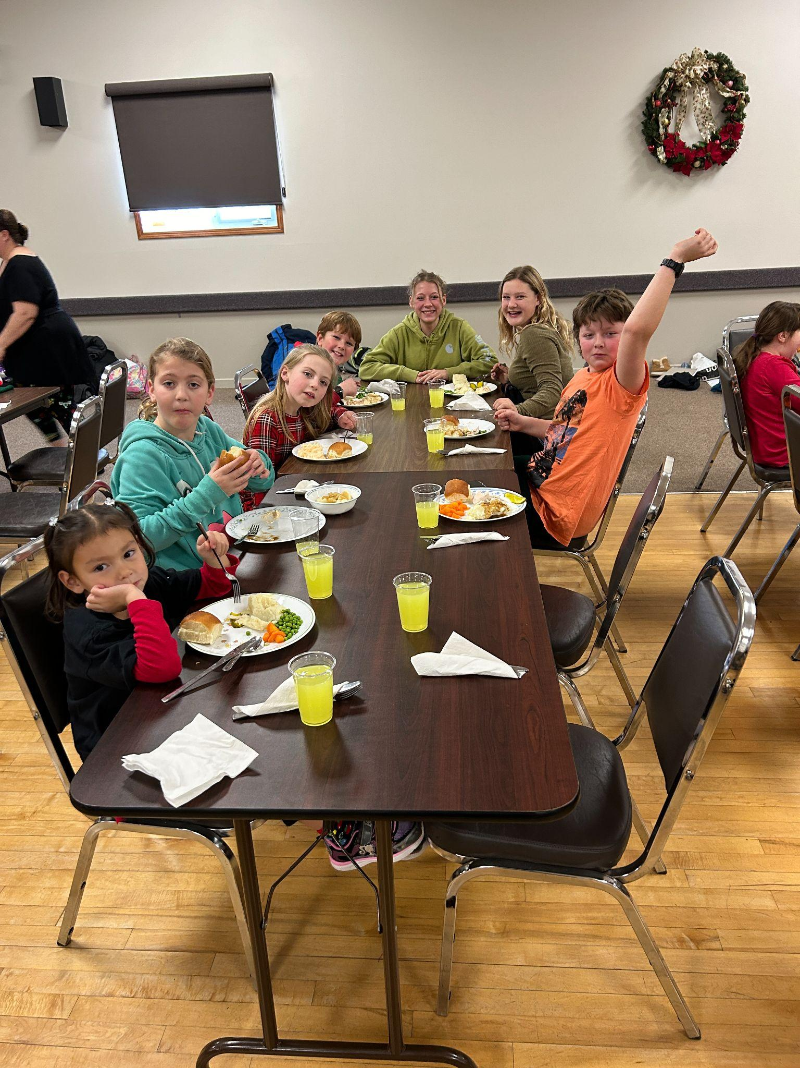
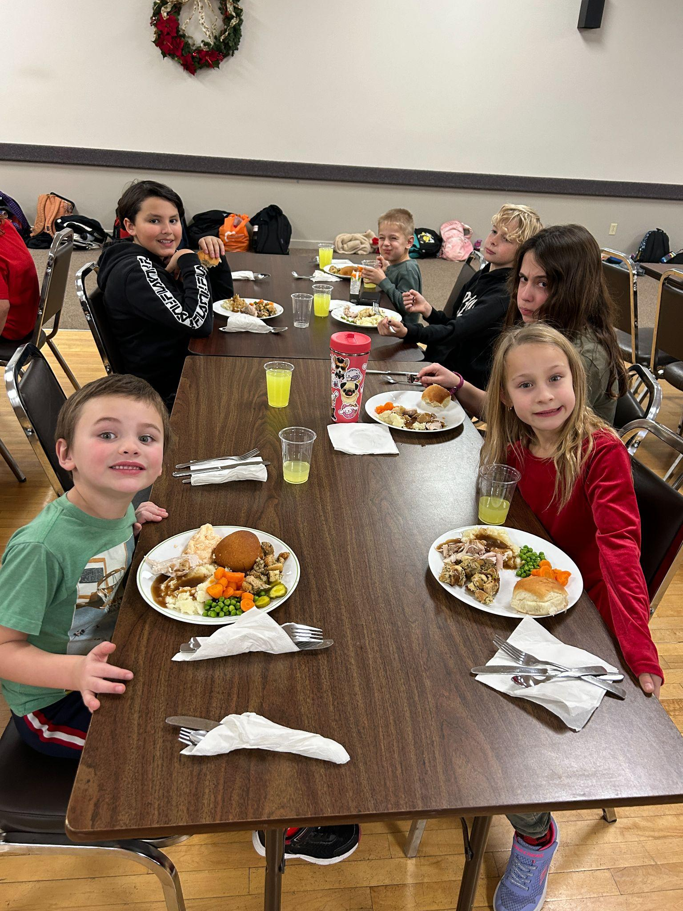
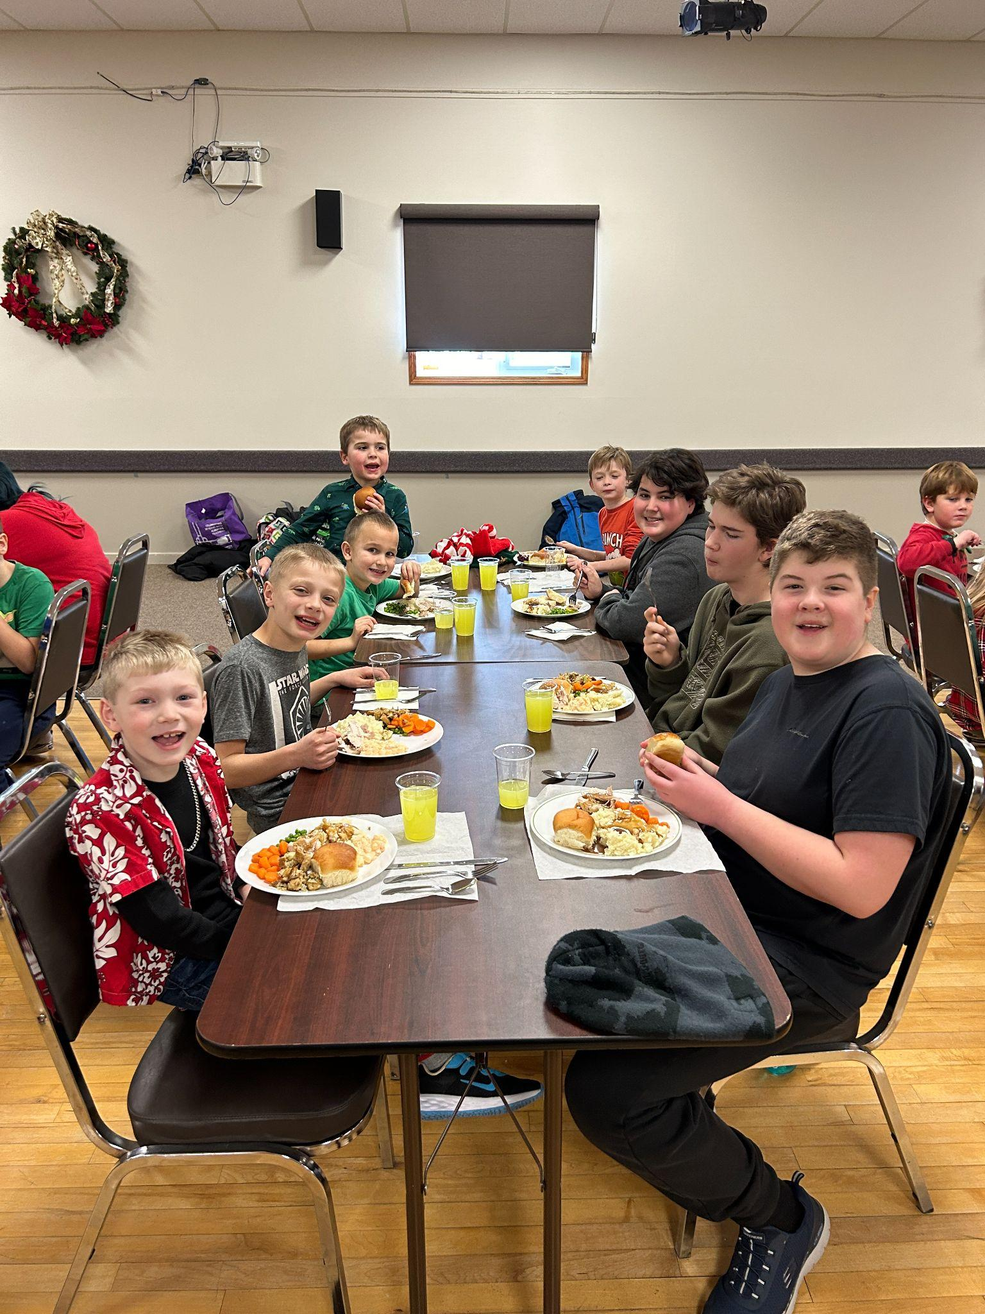
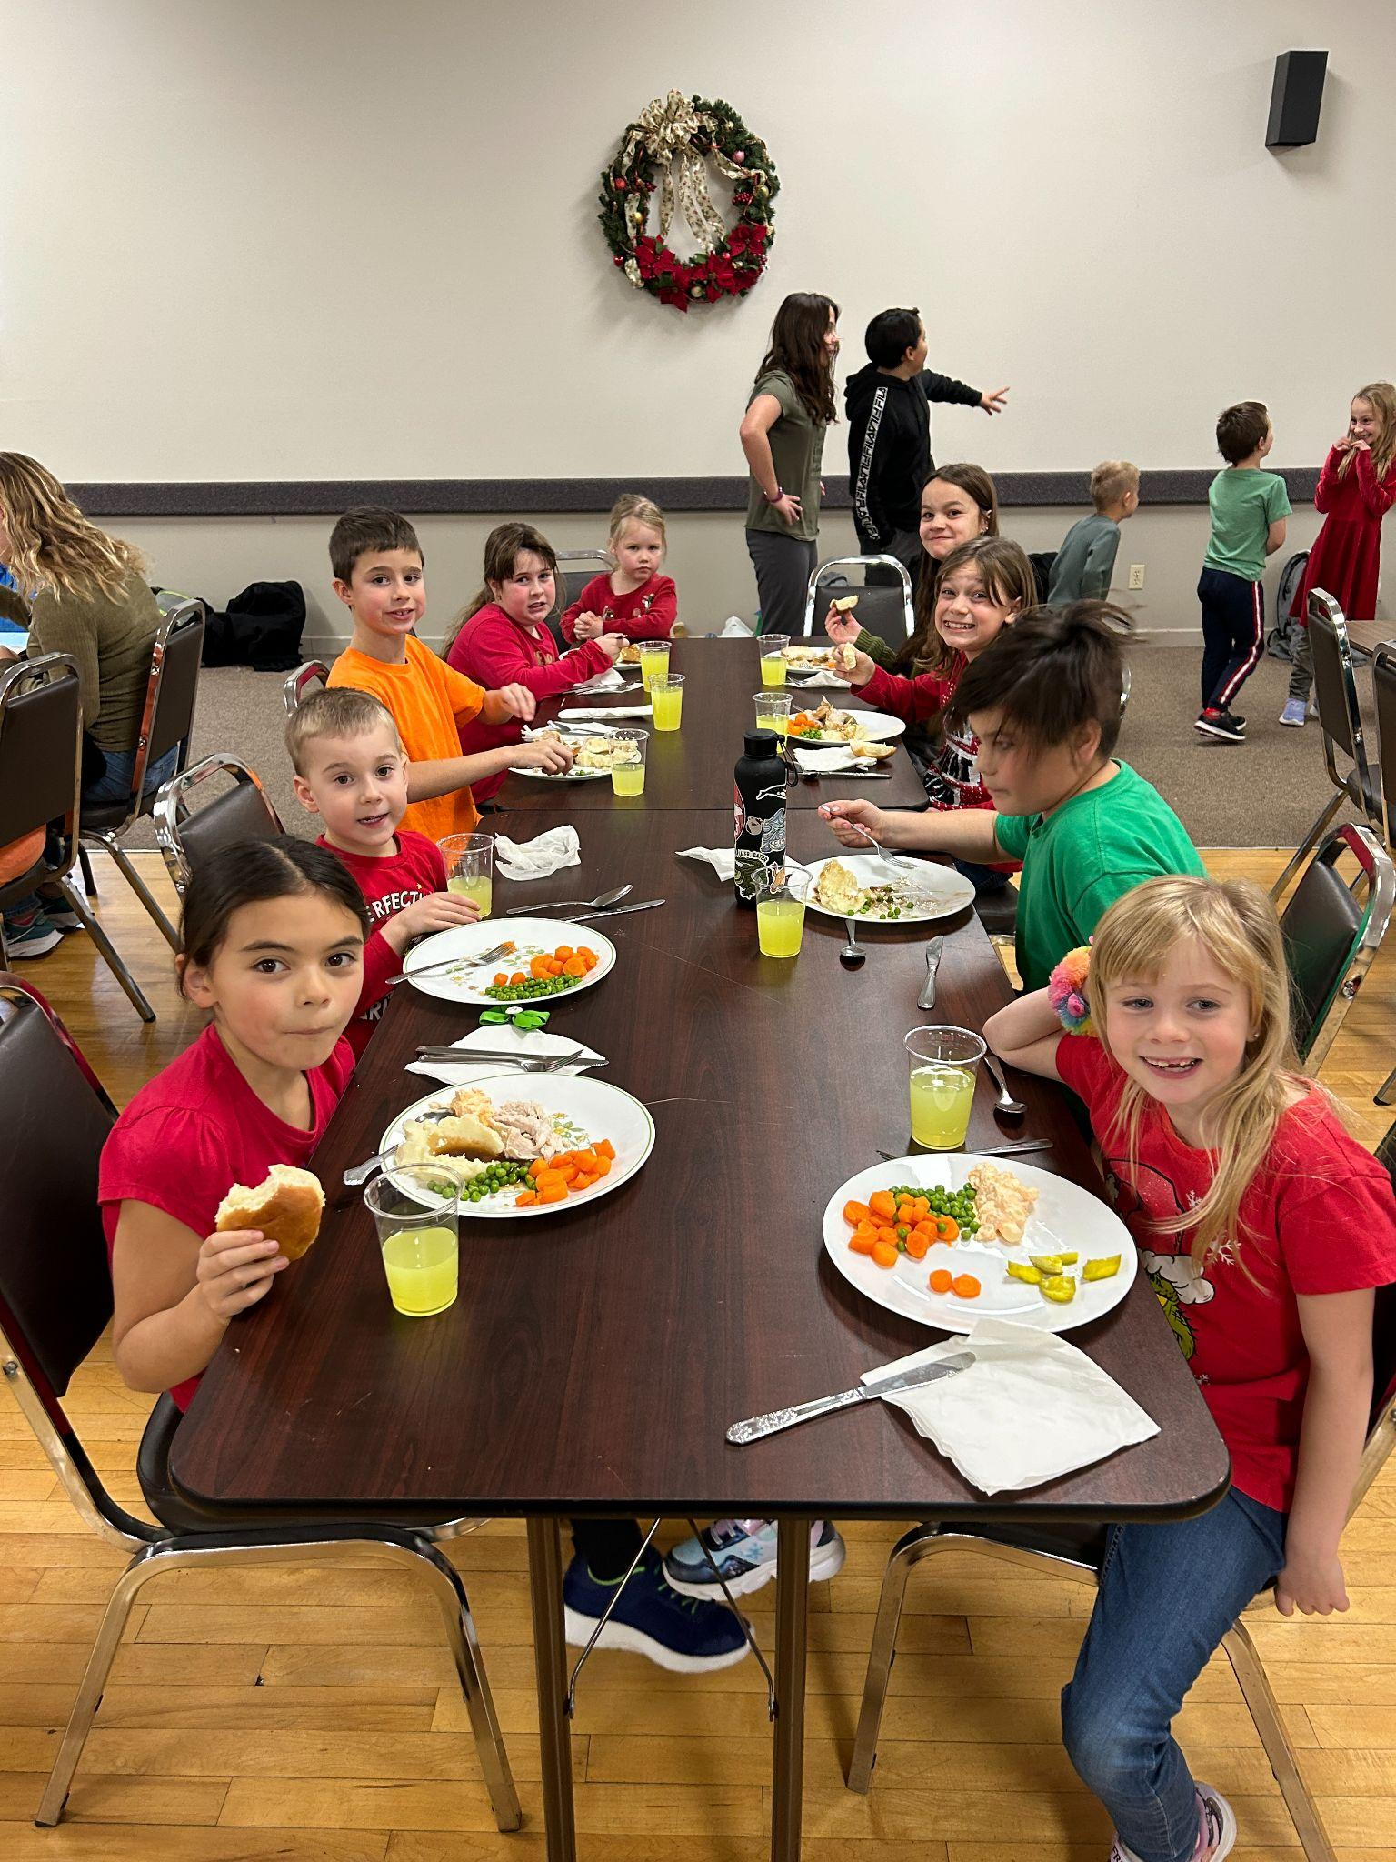
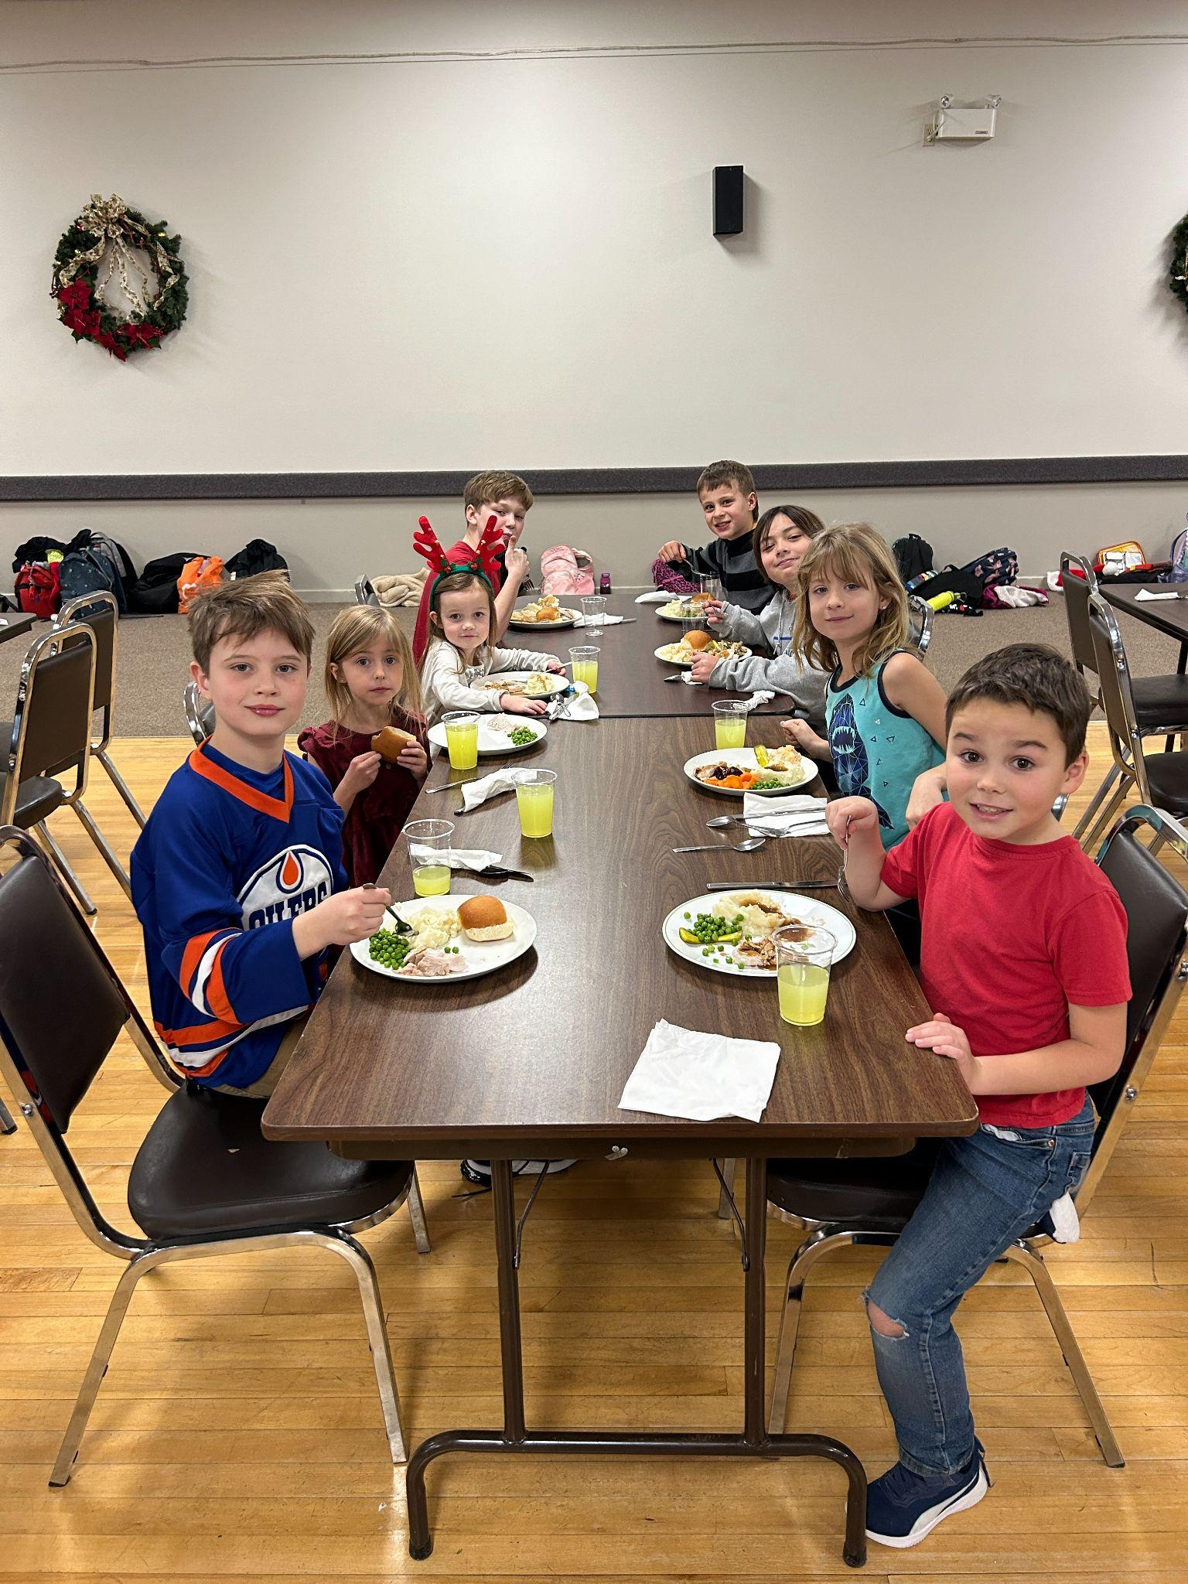
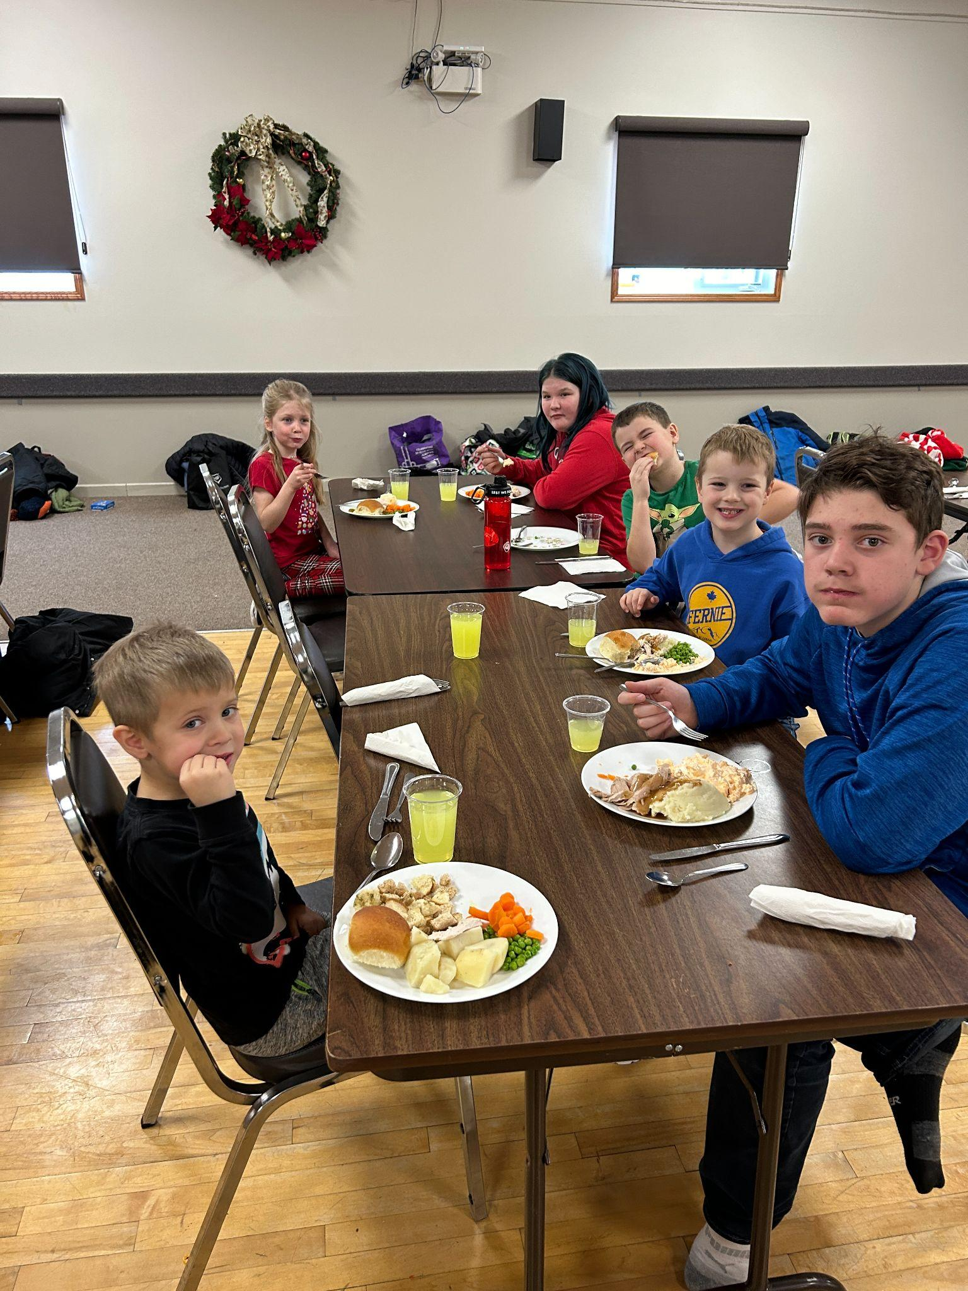
A BIG THANK YOU TO OUR PARENT COUNCIL AND VOLUNTEERS FOR AN OUTSTANDING CELEBRATION MEAL!
OUR ENTIRE SCHOOL APPRECIATES ALL THE HARD WORK YOU DO!

Slide 12
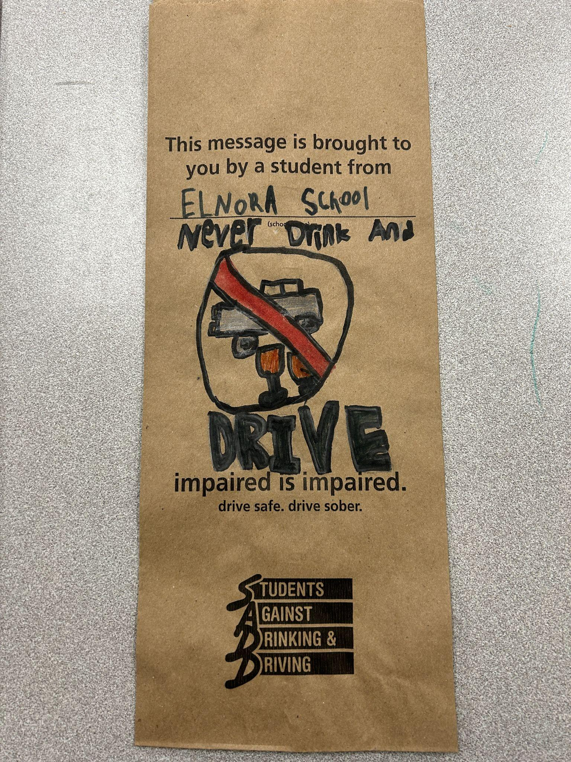
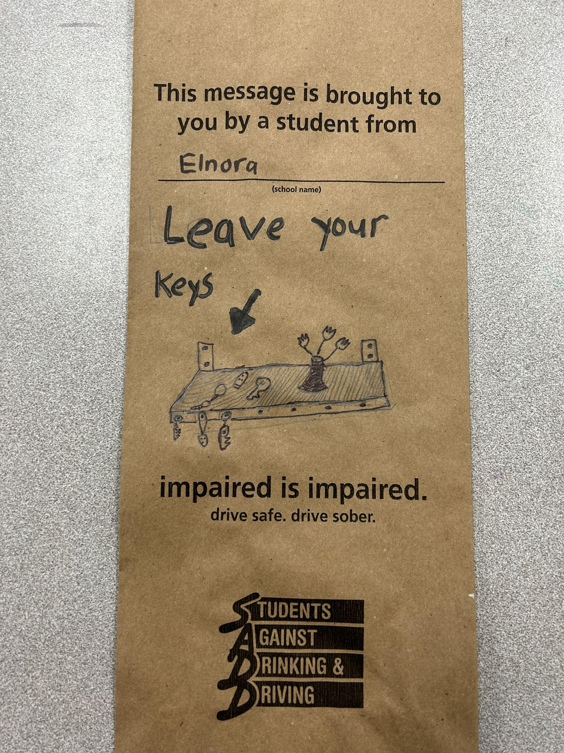
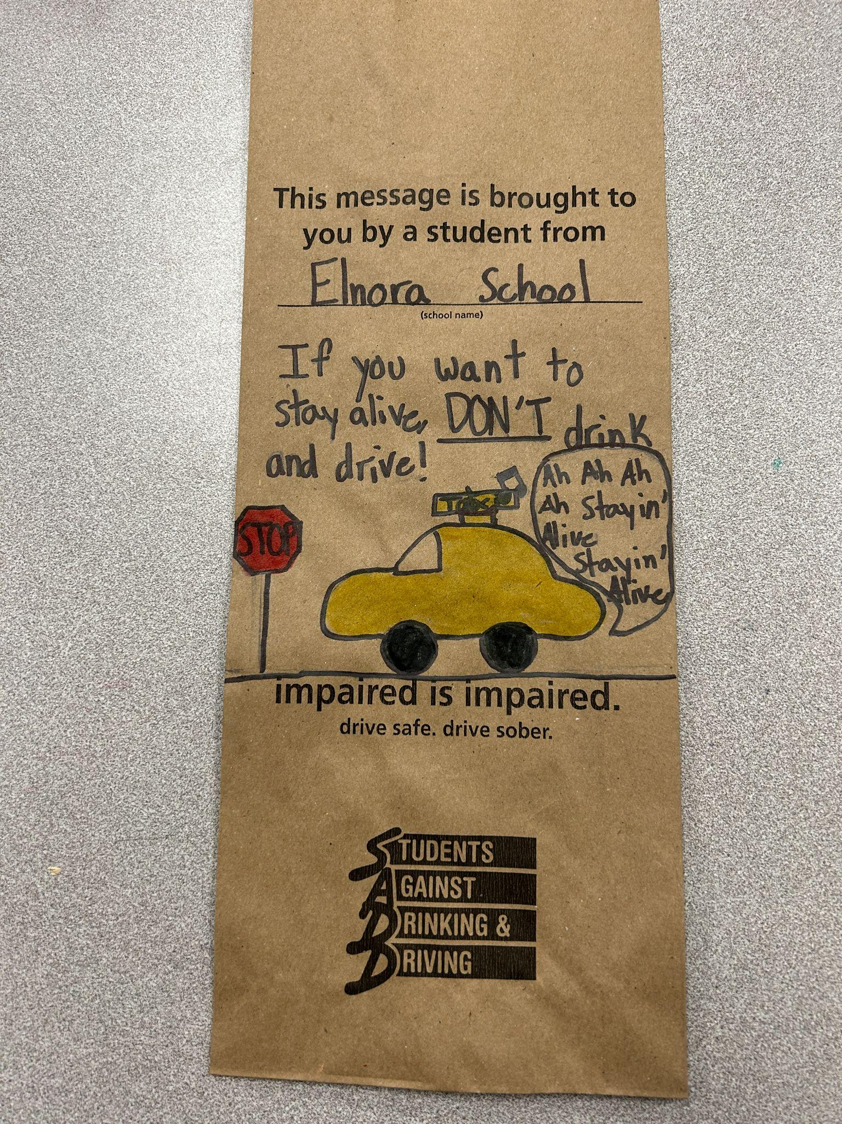
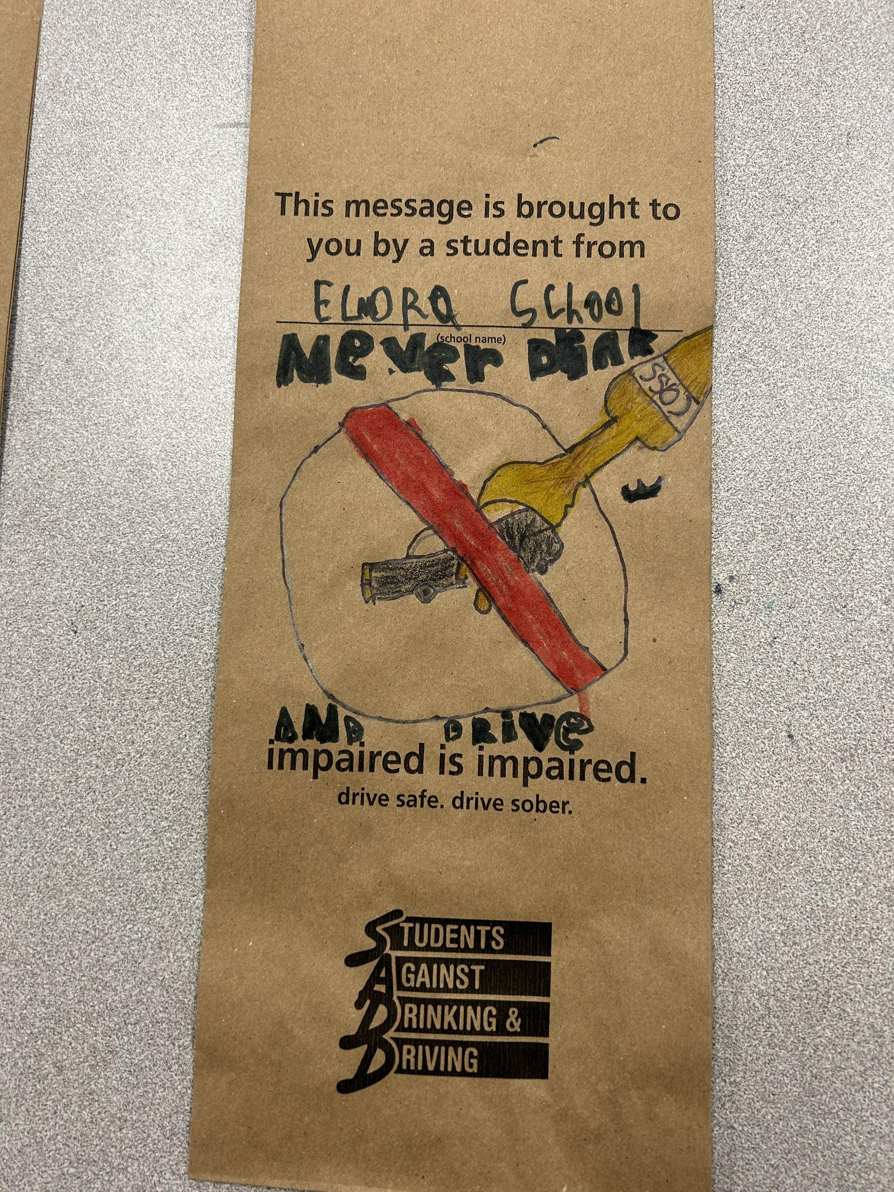
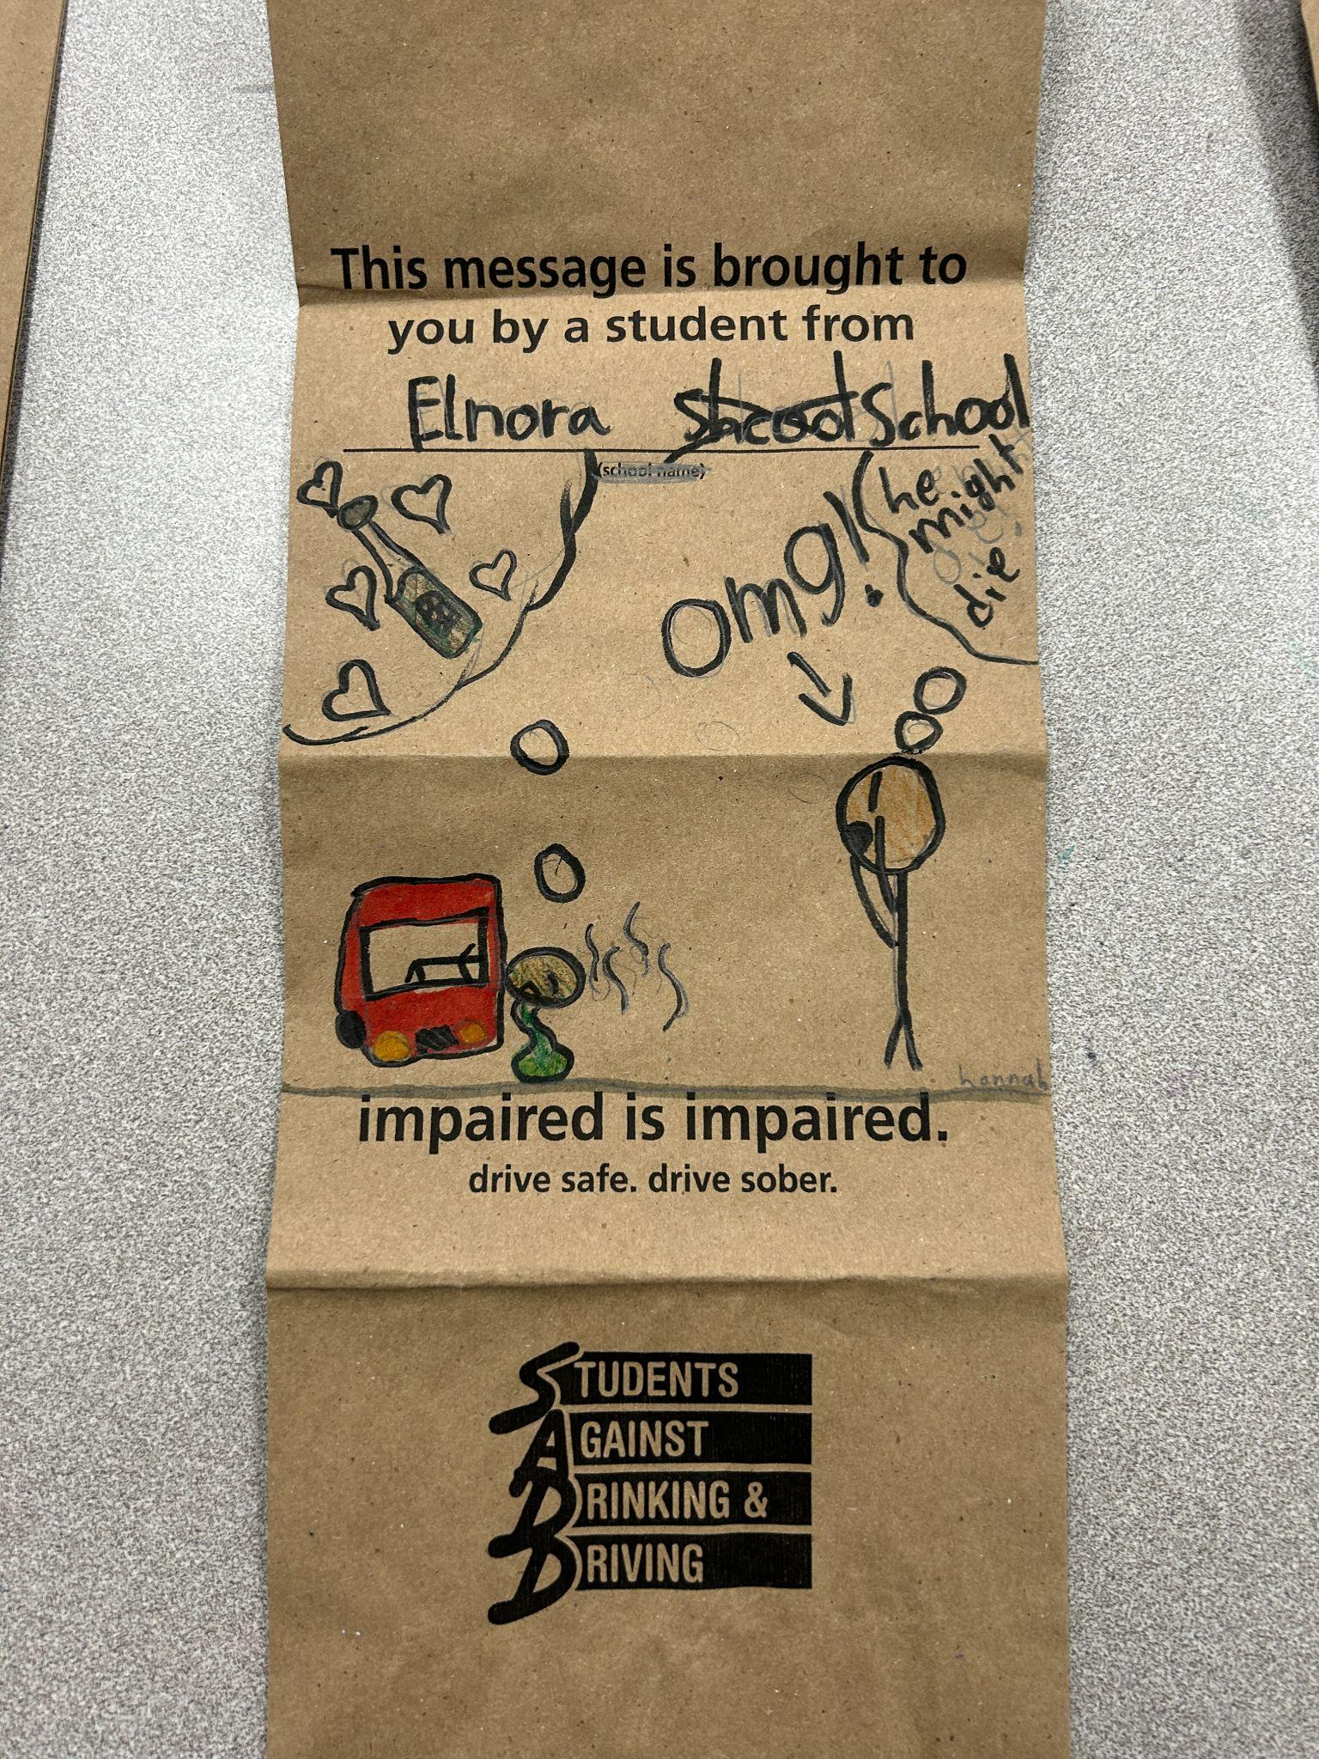
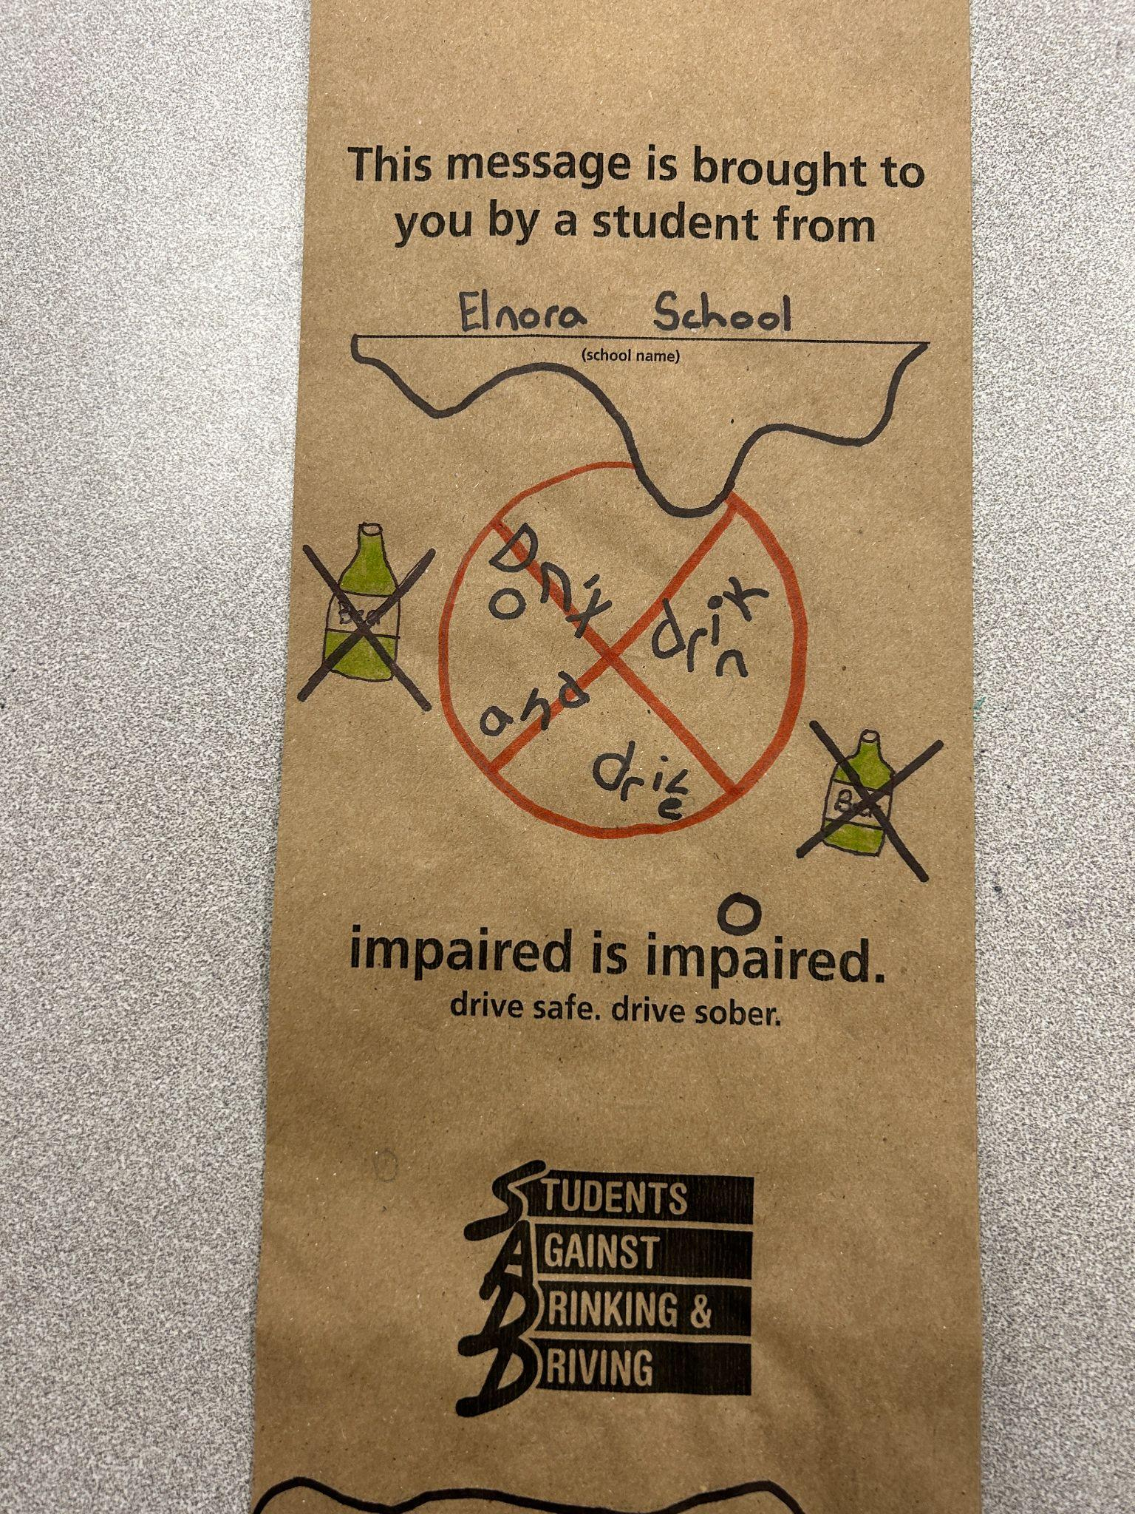
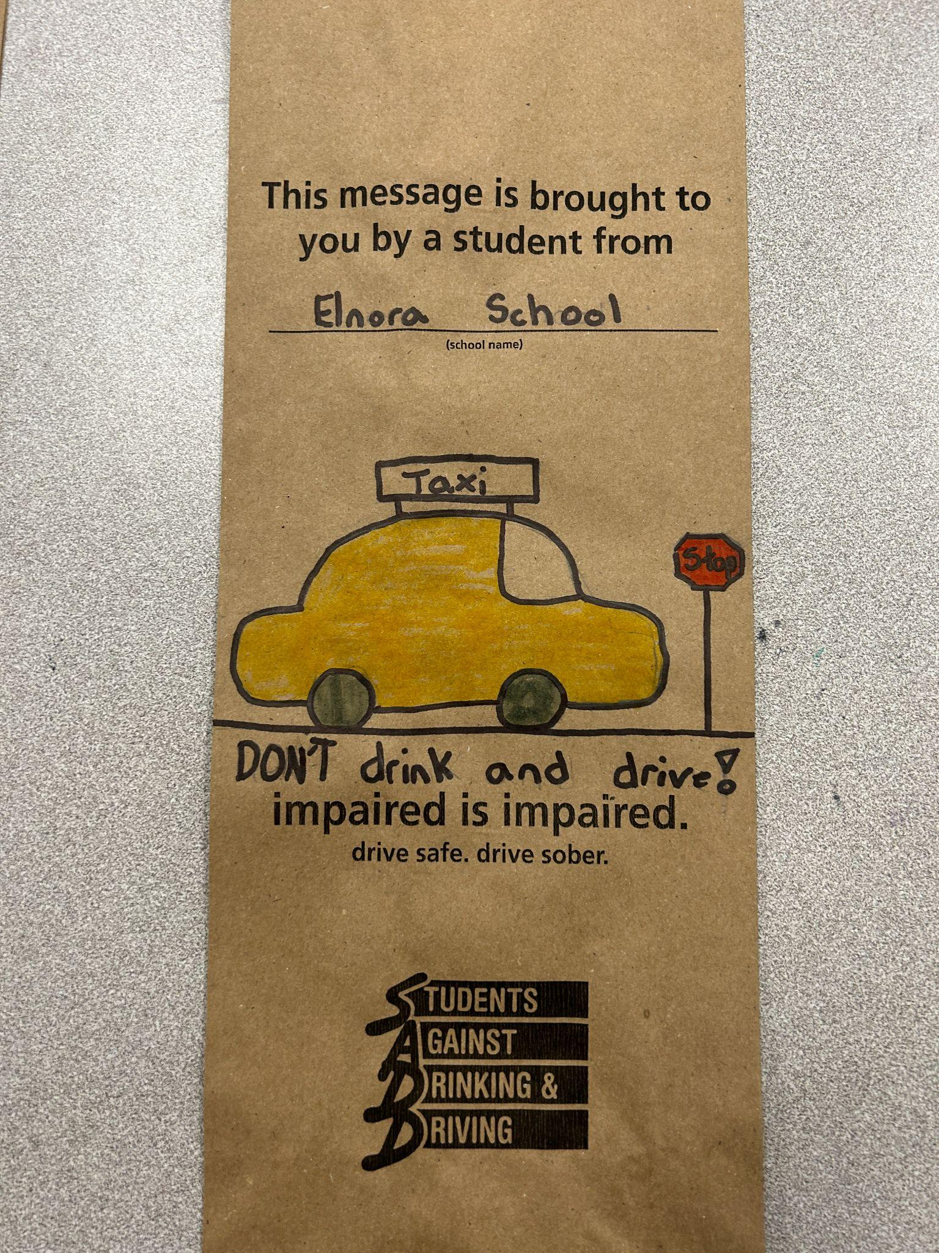
SADD Students against drunk driving.
Our students in health class support this program!

Slide 13
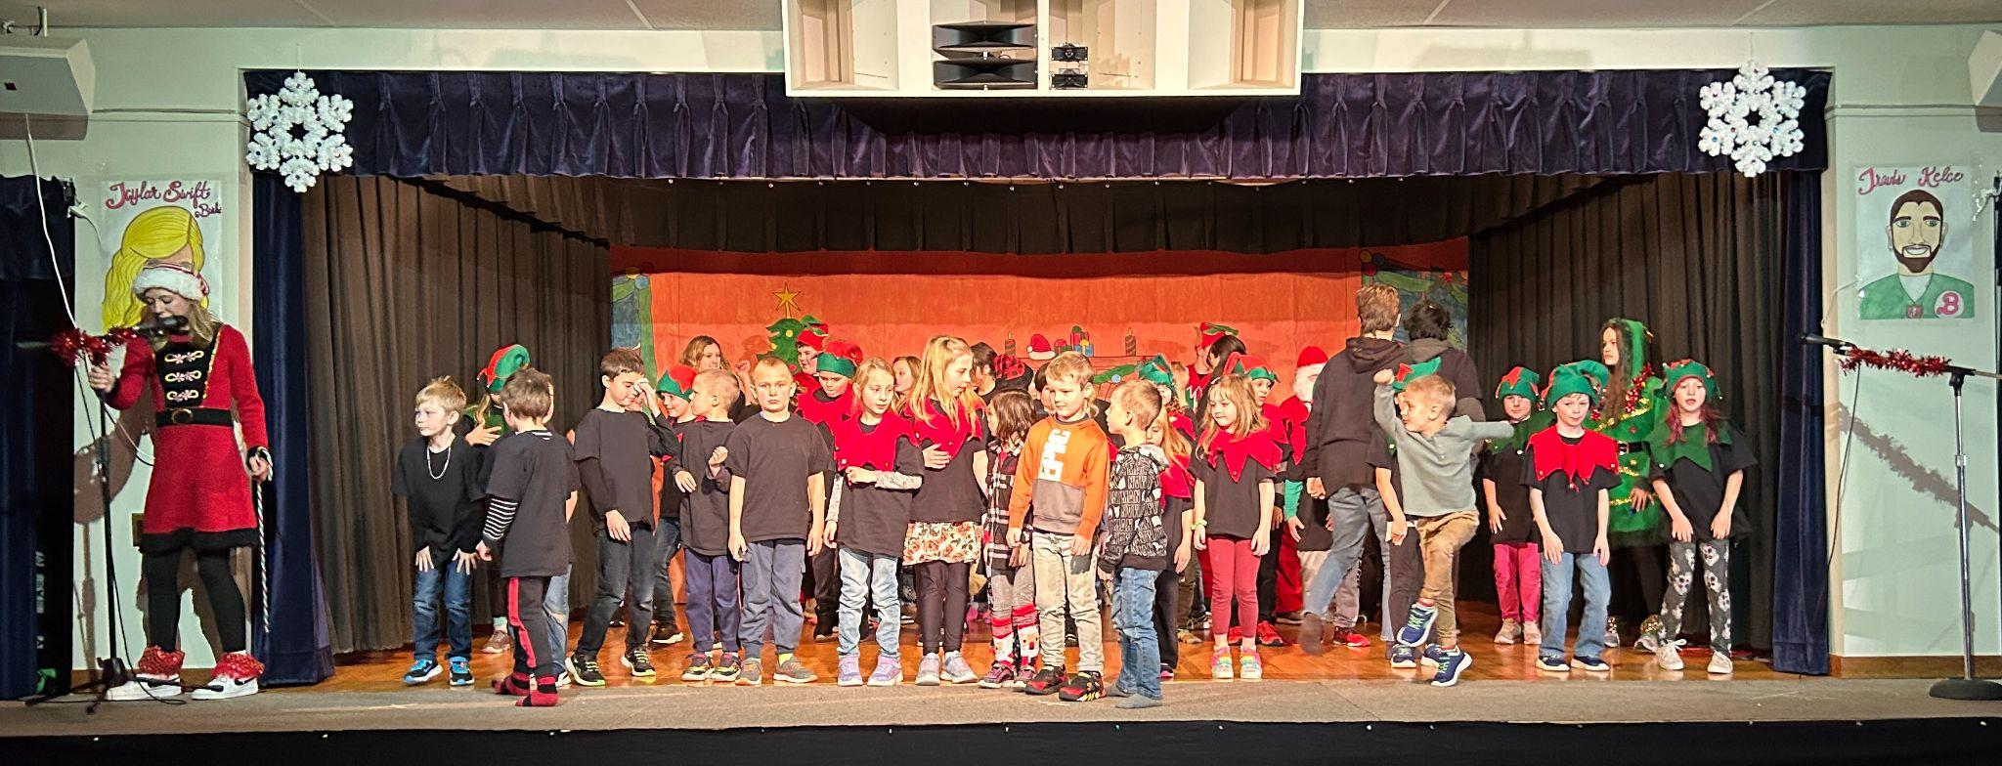
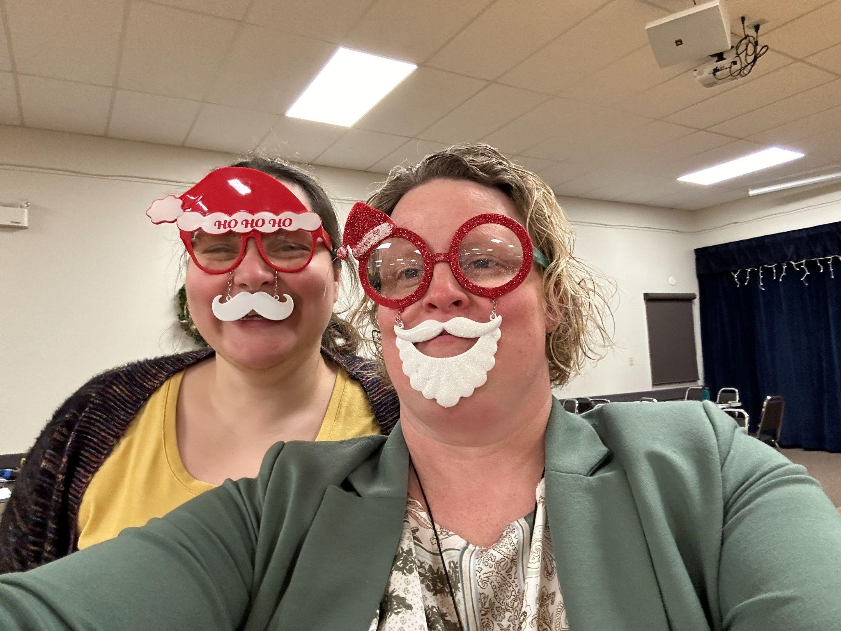
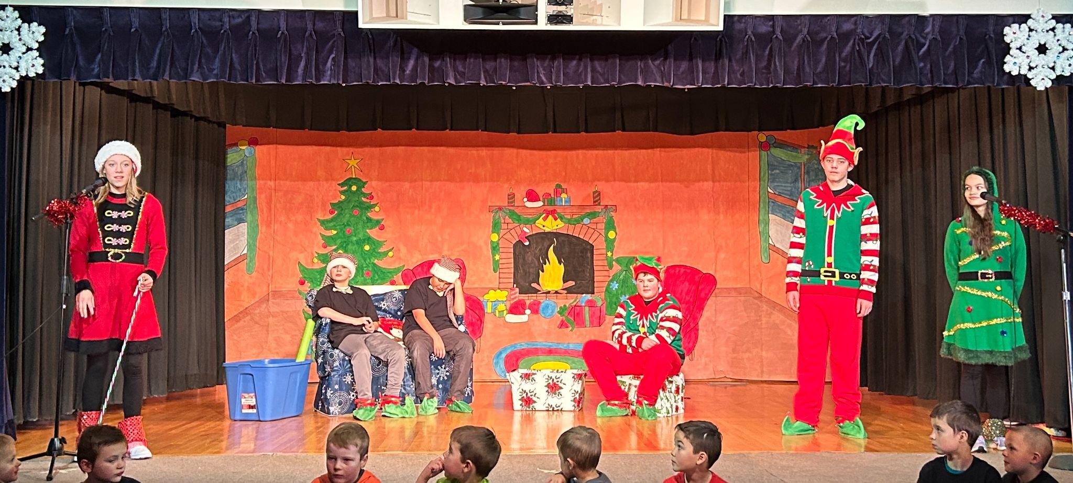
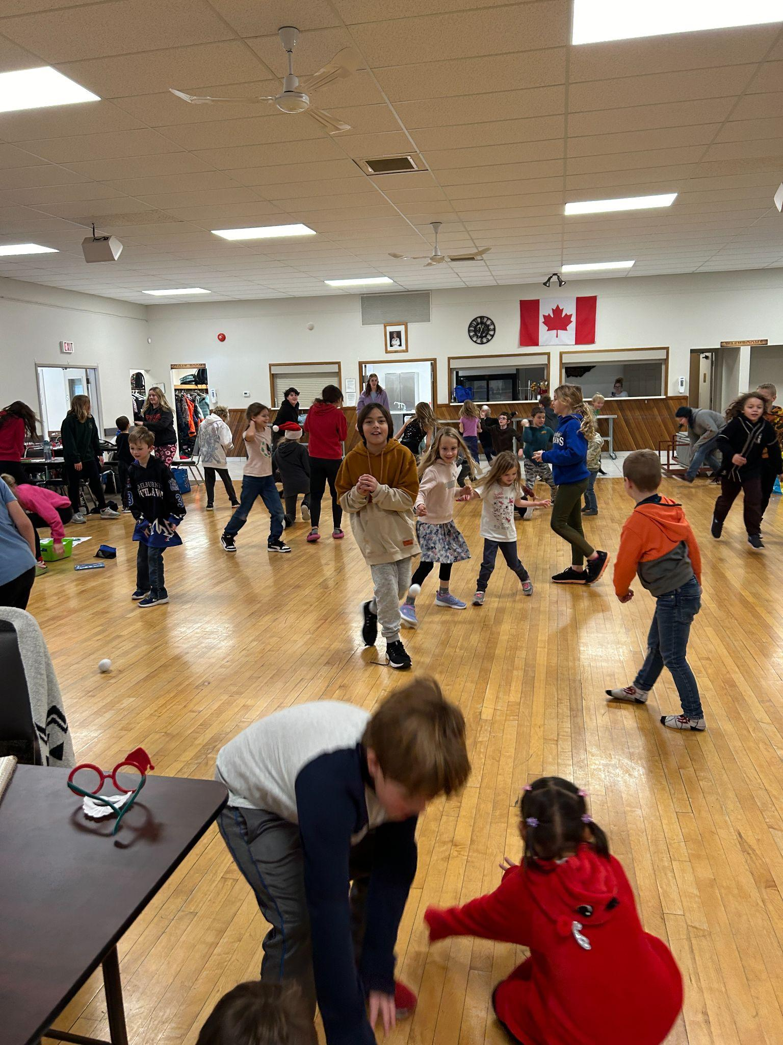
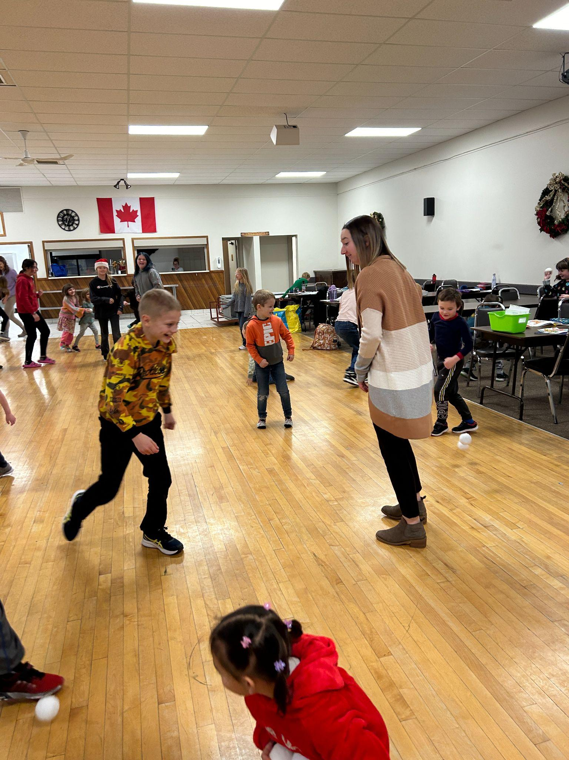
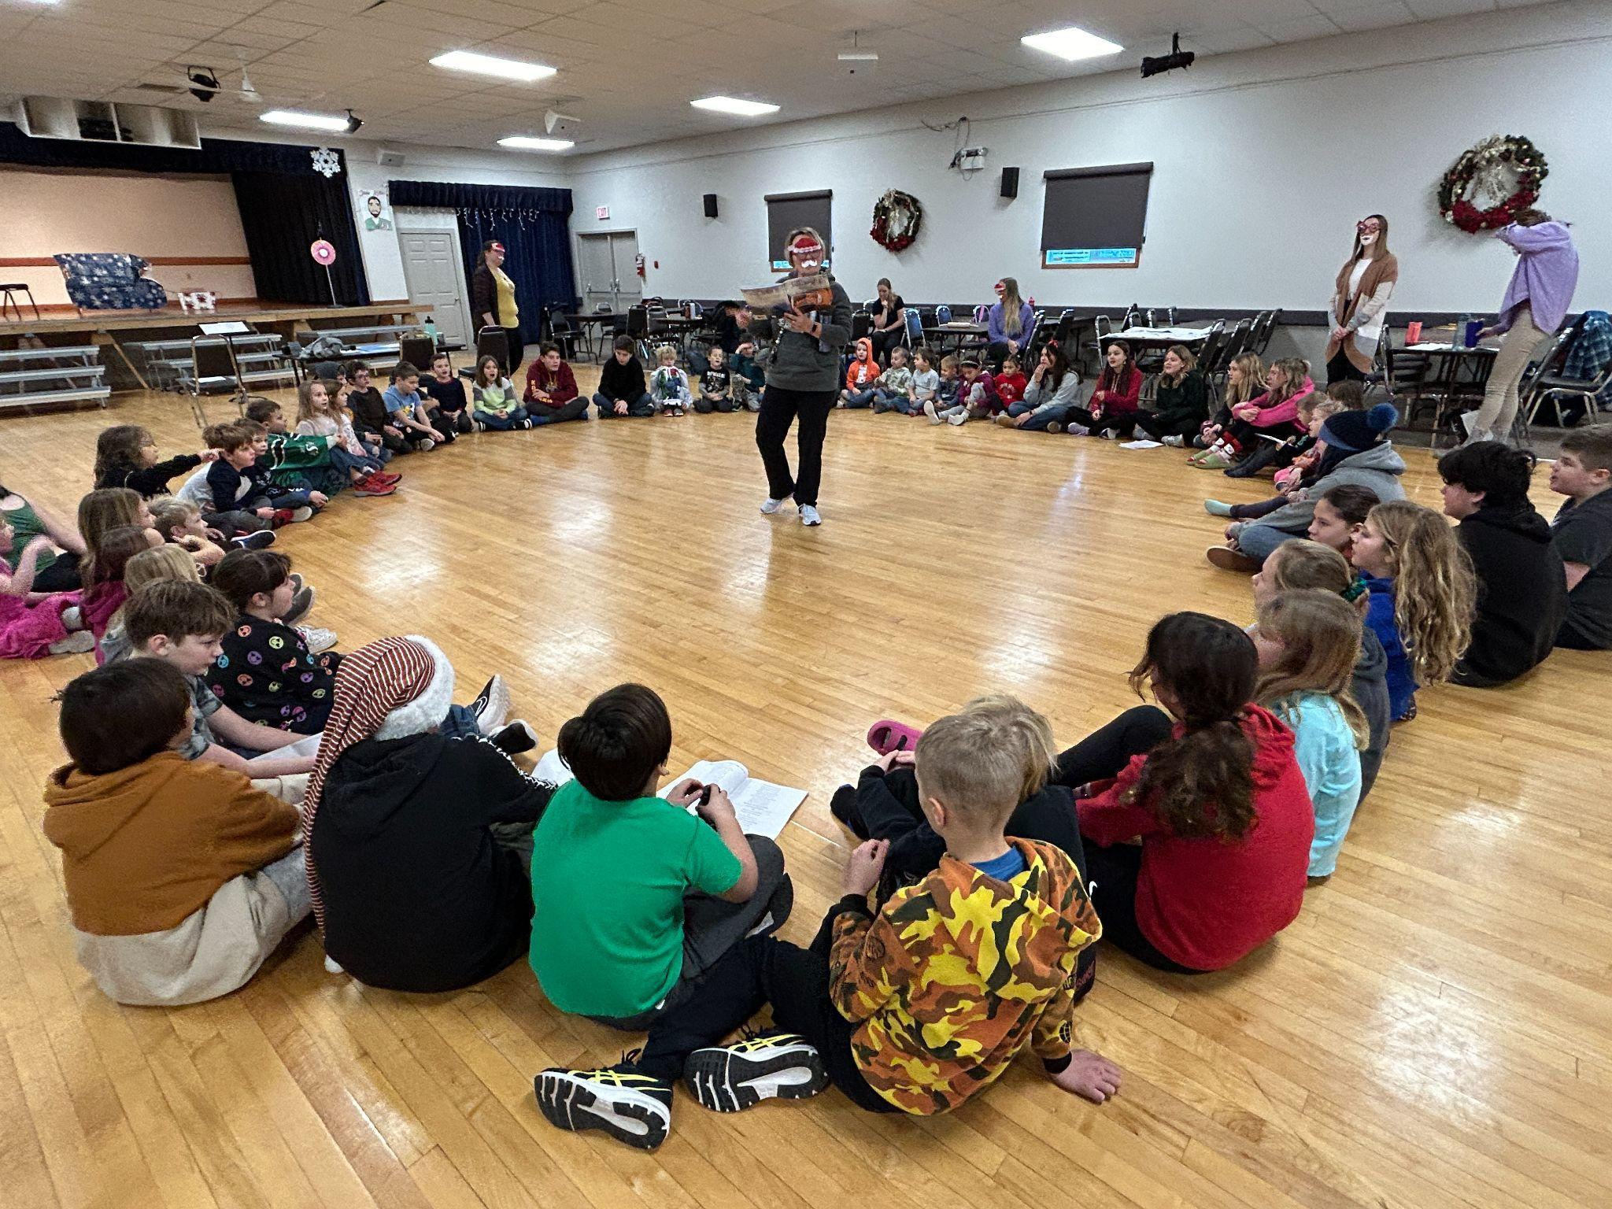
Annual Christmas Drama Production in all its glory! What an amazing show performed by our talented students, and directed by our dedicated teachers.

