Slide 1
It is the most wonderful time of year!
December is a busy month in schools. Our teacher's are working hard to balance learning opportunities, Christmas concert preparations, and fun and exciting Christmas celebrations.
Concert practice schedules have been sent out. Please remember to check it daily to know if students begin the day, or end the day at the hall. In addition to that important information, scheduled activities were in the letter. There are some fun days planned! Please remember to send in Lost Treasure donations as well as items for our nachos and games day! Hopefully the weather cooperates and we get to enjoy all the Christmas festivities.
Take some time this season to celebrate all that you love. From all of the students and staff here in Elnora School, we wish you all the best for the holidays. I hope you eat the cookies, play the games, have the snowball fights and celebrate with your friends and family. "May you never be too grown up to not search the skies on Christmas Eve."
Mrs. Leana Howard
Principal of Elnora School
“Learning For Life”
NEWSLETTER
December 2023/2024
Inside the Issue:
Principal’s Message 1
Calendar 2
Meet our New Student Teachers 3
Friendly Reminders 4
Lost Treasures Grade ½ 5
FCSS Winter Coats 6
Photos 7
Important Dates:
Dec 5th - Subway Hot Lunch
Dec 7th - Xmas Play Practice Hall AM
Dec 8th - Non Instructional Day
Dec 11th - Xmas Play Practice Hall PM
Dec 12th - Xmas Play Practice Hall AM - Lost Treasure 1-3
Dec 12th - Boston Pizza Hot Lunch
Dec 13th - Xmas Play Practice Hall PM
Dec 14th - Xmas Play Practice Hall PM
Dec 15th - Xmas Play Practice Hall AM
Dec 18th - Kinder Monday
Dec 18th - Xmas Play Practice Hall AM (with Kinders)
Dec 18th - Christmas Headwear Day
Dec 19th - Red & Green Day
Dec 19th - Xmas Play Practice Hall AM (with Kinders) - Turkey Dinner
Dec 20th - Christmas Sock Day
Dec 20th - Xmas Play Practice Hall AM
Dec 21st - Christmas Sweater Day
- Xmas Play Practice Hall AM - Nachos & Board Games - PM
- CONCERT 7PM
Dec 22nd - PJ Day / Swim (9:30-11:30) & Movie
Dec 23rd - Jan 7th - Christmas Break
Principal’s Message
Find Us
www.elnoraschool.ca
Facebook: @elnoraschool
Instagram: @elnoraeagles
Join the Elnora Parent Council Facebook Group

Slide 2
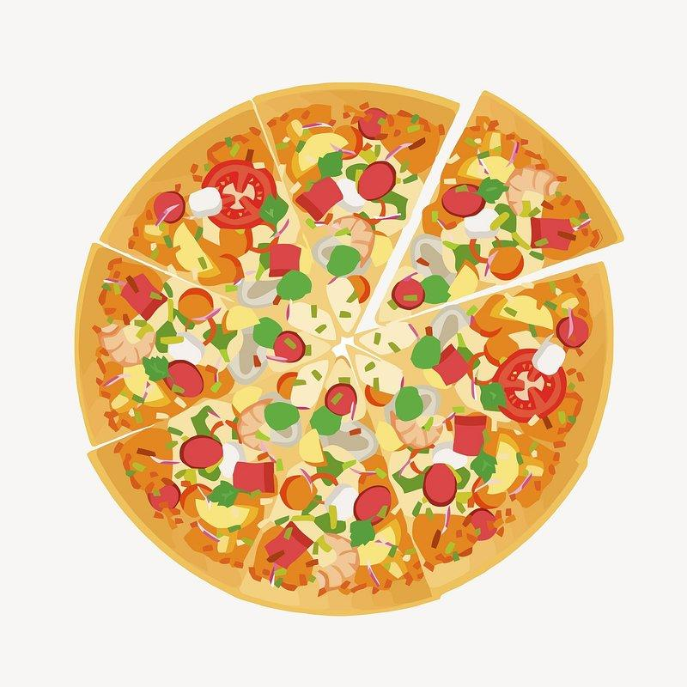
December 2023
M
T
W
Th
F
 |  |  |  |  | 1 | 2
3 | 4 | 5 Hot Lunch Day | 6 **Boston Pizza orders due** | 7 Xmas Play Practice Hall AM | 8 Non Instructional Day | 9
10 | 11 Xmas Play Practice Hall PM | 12 Xmas Play Practice Hall AM Lost Treasure 1-3 Boston Pizza Hot Lunch | 13 Xmas Play Practice Hall PM | 14 Xmas Play Practice Hall PM | 15 Xmas Play Practice Hall AM | 16
17 | 18 Christmas Headwear Day Xmas Play Practice Hall AM - with Kinders Kinder Monday | 19 Xmas Play Practice Hall AM - with Kinders Turkey Dinner RED & GREEN Day | 20 Xmas Play Practice Hall AM Christmas Sock Day | 21 Xmas Play Practice Hall AM Nachos & Board Games PM CONCERT 7PM Christmas Sweater Day | 22 Swimming 9:30am-11:30am Movie Day PJ Day | 23
24 | 25 CHRISTMAS | 26 BREAK | 27 HAVE A | 28 MERRY | 29 HOLIDAY | 30/31

Slide 3
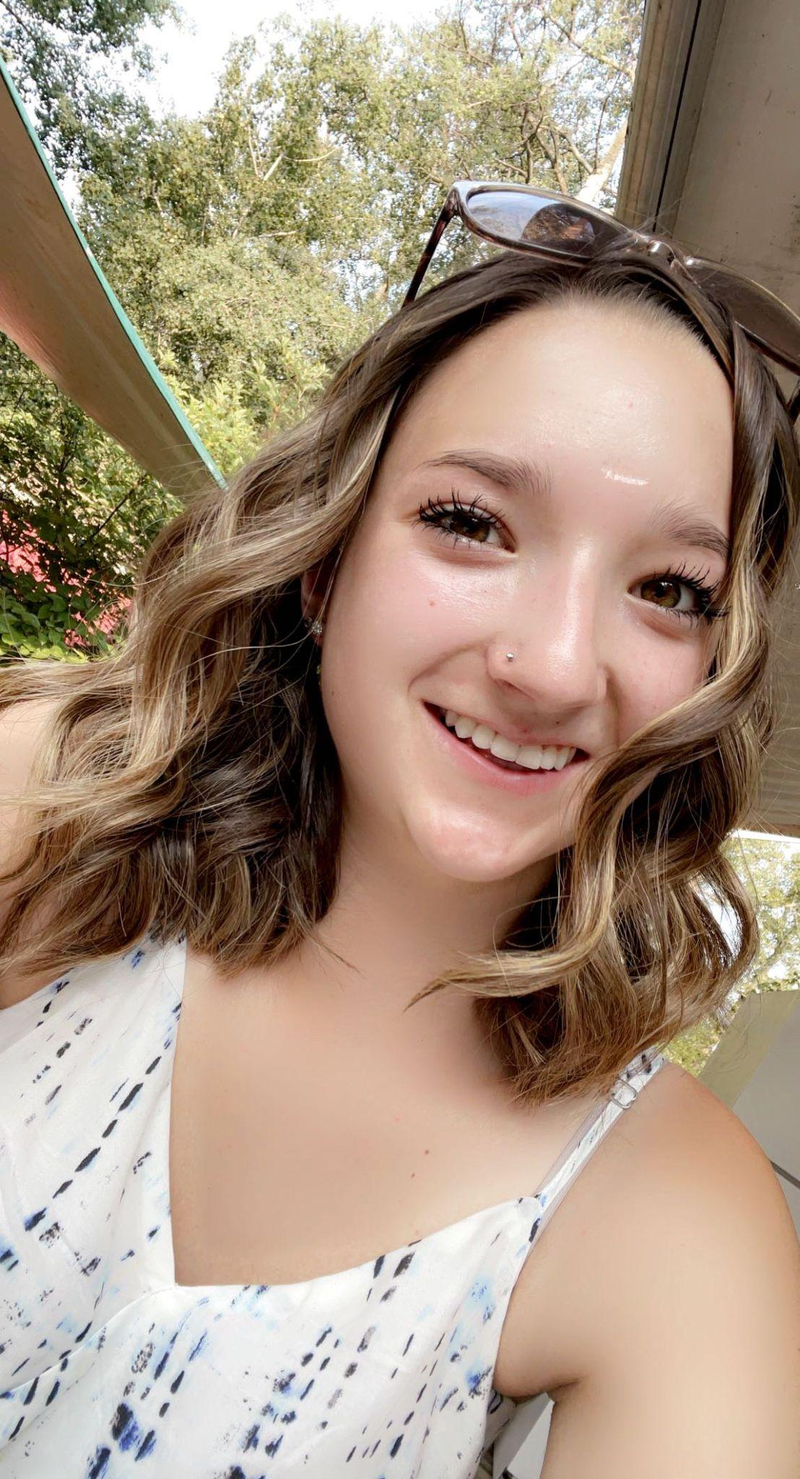
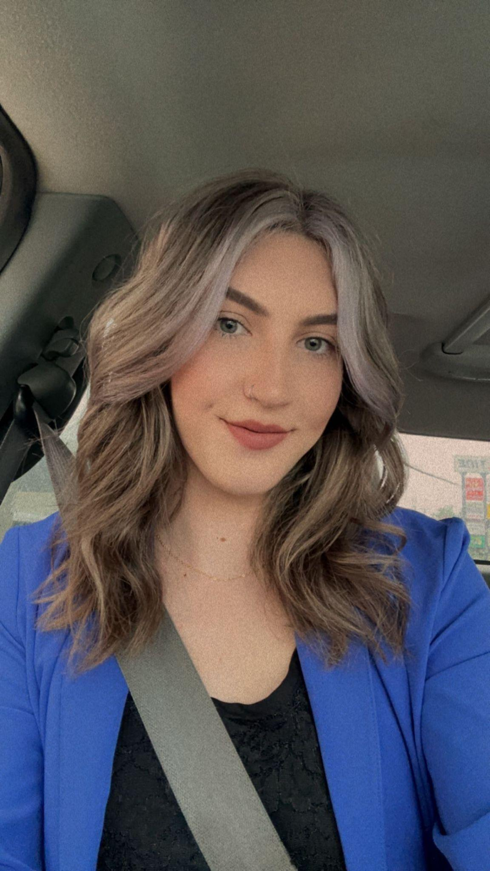
Meet our New Student Teachers
We are always very grateful when we get to have student teachers join us during their schooling. They get to experience classroom and all the diversity within the school.
This year we get two student teachers! We have them until Christmas break, so if you see them in the hall or classroom say hello and make them feel welcome!
~~~~~~~~~~~~~~~~~~~~~~~~~~~~~~~~~~~~~~~~~~~~~~~~~~~~
My name is Kaylee Raniseth and I am in my third year of my Bachelor of Education at Red Deer Polytechnic. I am a competitive curler and have done many other sports throughout my life. In my free time I teach dance and Aerial Silks/Lyra Hoop. You can also find me hanging out with my friends and family or reading a book. I spend my summer camping out at Buffalo lake, hiking and paddleboarding during sunsets. I am an animal lover and have two cats and two dogs that get a lot of attention! I have had such a wonderful time growing my experience and getting to know each and every student. I appreciate the warm welcome and can't wait for the next coming weeks.
Hello!
My name is Kacey Jackson, I am in my 3rd year of my Bachelor of Education in Elementary, with a Minor in Physical Education. I was very fortunate to be given the opportunity to be a Preservice Teacher under Mrs. Peterson, in her grade 1/2 split class. After graduating from Delburne Centralized School, I decided to take a gap year to gain some experience in the real world as a young adult, during that time I was able to gain loads of experience working with children and furthering their development through working in various Child Care programs in the Red Deer area. Being born and raised on a farm near Lousana, I am happy to be able to learn in a rural school like the one I attended from K-12. Some things I love to do when I'm not learning how to be the best educator I could be, is spending time with my family and friends, horseback riding, sports, being outdoors and dancing. You may catch me rocking out and singing my heart out to any song that comes on, even though I cannot carry a tune in a bucket. I am a very proud dog/cat mom to my 2 Miniature Dachshunds (Wiener Dogs), Luna Tuna and Cocoa Bean, and my beautiful Tabby Cat, River Lily. My goal as an educator is to be able to form strong bonds and caring relationships not only with each and every student I encounter, so that I can have a better understanding of how to further their development in a fun, exciting and joyful way, but also their parents/guardians to collaboratively help the children succeed! I feel so honored, excited and happy to be a part of the Elnora School team for the next few weeks while I learn from the many AMAZING staff about the best ways to educate our future generations!

Slide 4
Reminders for December
Thank you for remembering that we are a Nut Free School. We have some students that are very allergic to peanuts and other nuts so please do not send food containing nuts to school. We want to keep everyone safe and healthy.
Our staff would like to also remind you that with the cold weather approaching to make sure your kiddos have warm winter gear on. We still do outside recess until -40 weather so please try and have their stuff in their backpacks if possible. If anyone is in need of some items for their kids, please call the office and talk to Miss K!
Gym wear for our bigger students. Please make sure your child has extra gym clothes with them. We are running out of some extra clothes that we have here, we really want them to be able to participate in the activities planned for their gym classes. When they do not have the appropriate clothing, it stops them from being able to participate. Just a friendly reminder to please make sure they have this with them!
We have been working hard on our Christmas play this year. We will be having a silent auction as well. If there are any items or products that you would like to donate for the silent auction, they would be greatly appreciated. Please call the school if you have any questions.
Christmas break is upon us, we are all very excited to have some time off to spend with family and friends. From all of us at Elnora School we hope you have a wonderful Christmas and a very Happy New Year. Can’t wait to see you all next year!!

Slide 5
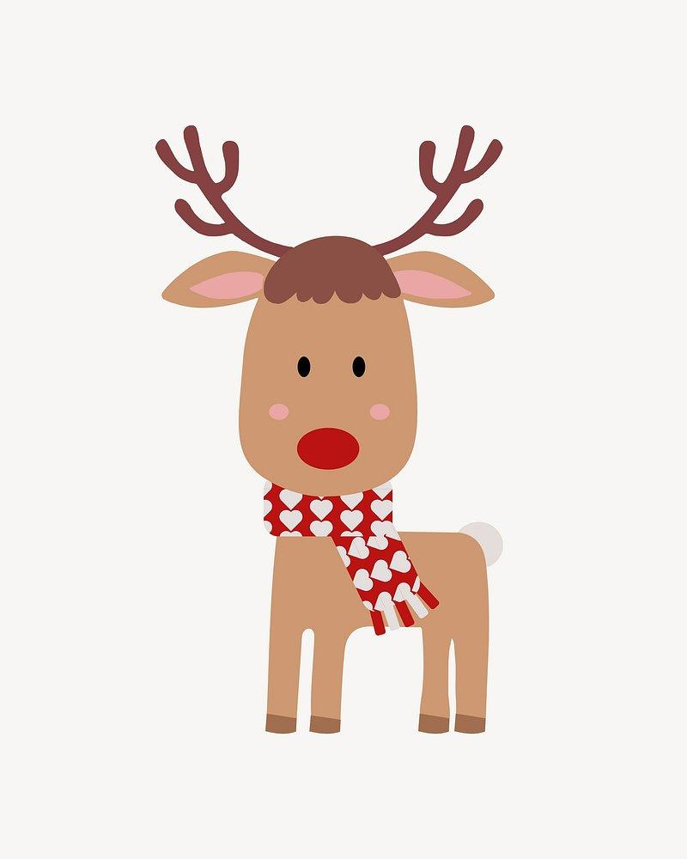
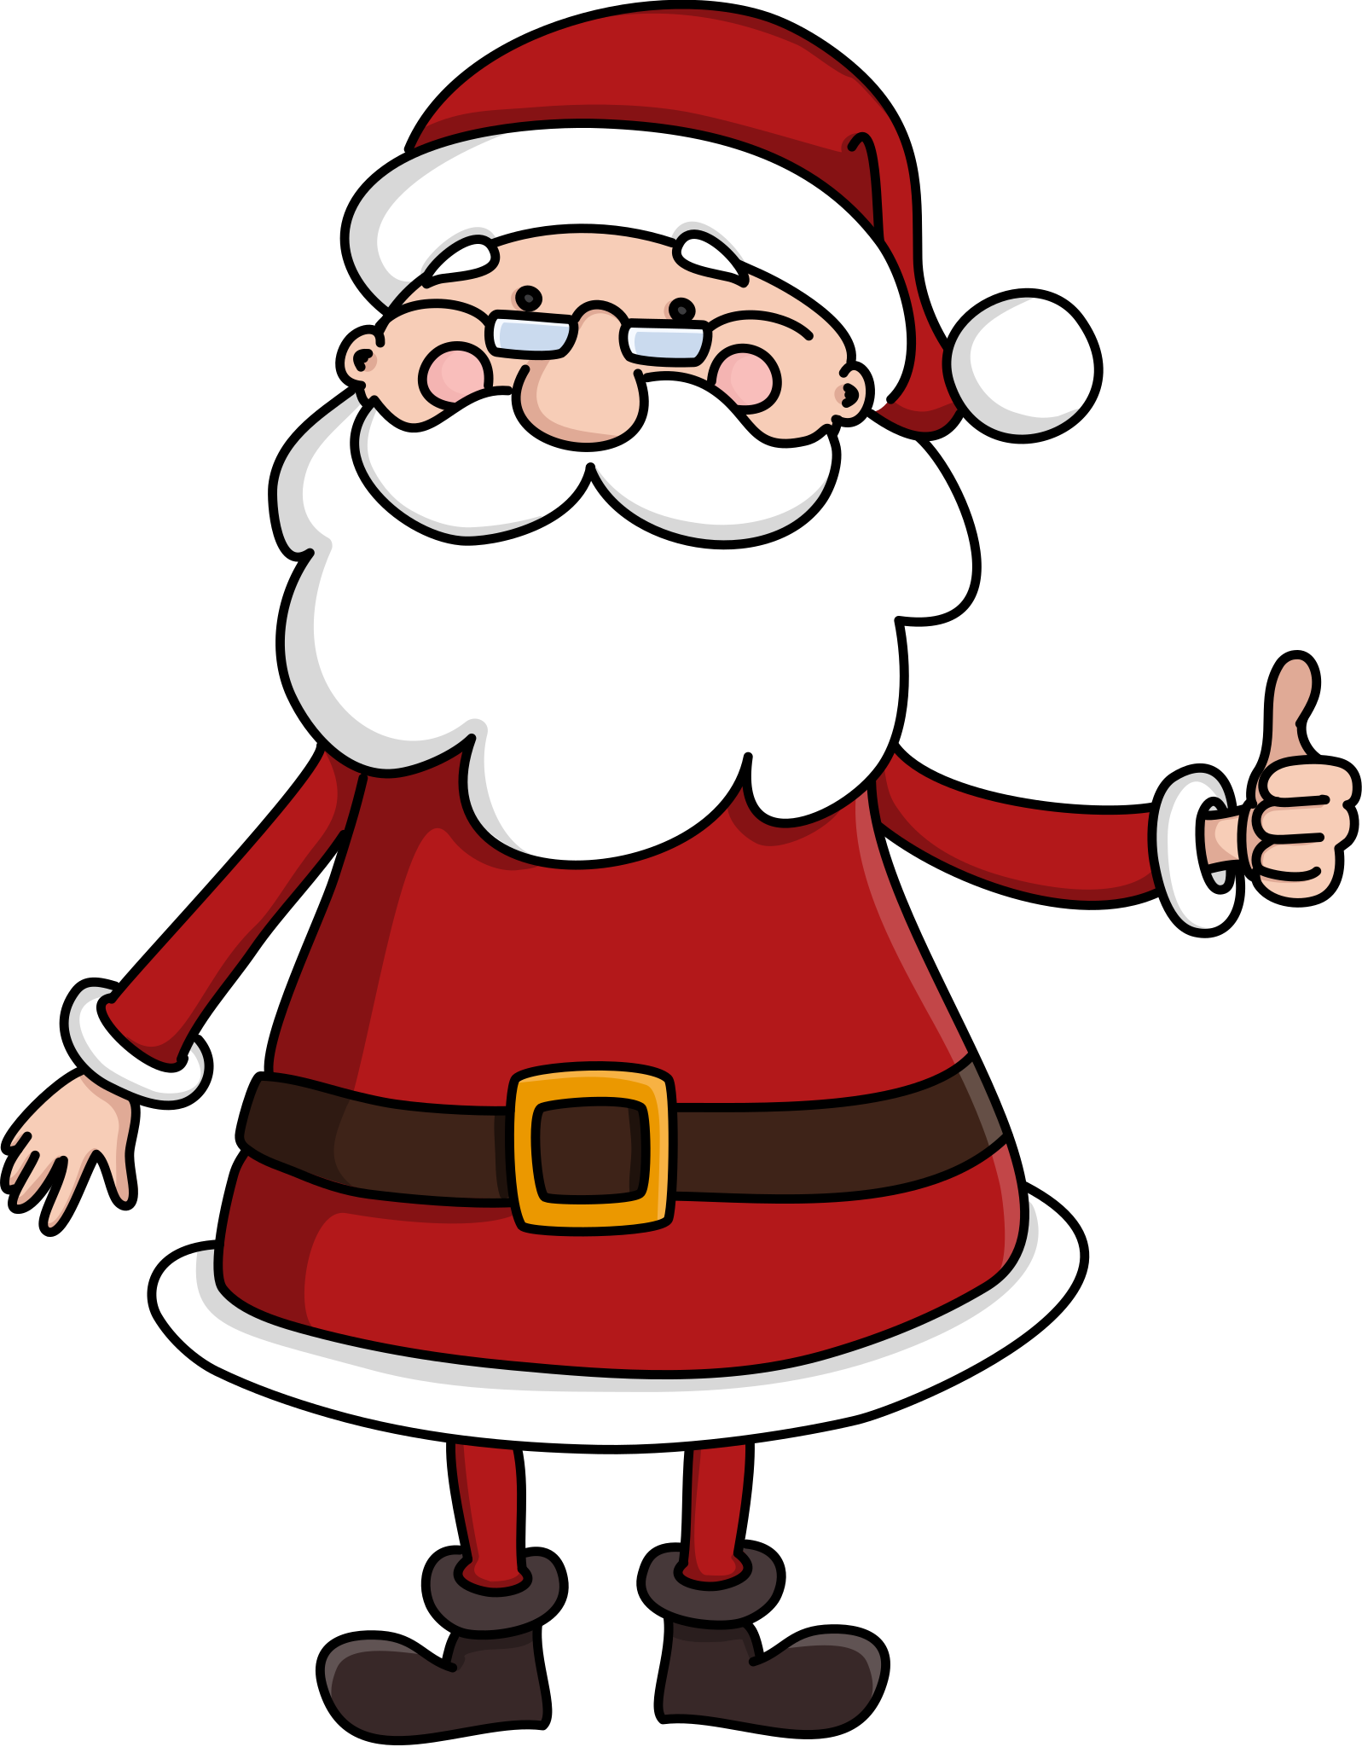
LOST TREASURE SALE
If you are doing some fall cleaning, please save your treasures!
The leadership class is excited to host the annual “Christmas Treasure” Sale on December 12th, 2023. We are looking for donations of gently used items that can be sold in our sale. Each item will be sold for a loonie or a toonie. The students of the school are invited to shop for gifts to give their family and friends at Christmas. A wrapping table will be set up so the students can wrap and decorate the presents for their loved ones.
Donations can be brought to Mrs. Peterson’s room from now until December 5th.
Donations of wrapping paper, Christmas gift bags and gift tags would be appreciated.
Lost Treasure Sale: Tuesday, December 12th. Please send money on this day for Christmas gift purchases.
POSSIBLE DONATION ITEMS | DO NOT SEND
Toys for all ages | Clothes
Books for all ages | Hats / Toques
Decorative Knick Knacks | Shoes
Christmas ornaments | Broken Items
Puzzles or games | Dirty Items
DVD’s | Large Heavy Items
Jewellery (No Earrings)
CLEAN stuffed animals
REMEMBER… Some of these treasures may end up under your tree so donate wisely…any items not sold will be donated to charity!
Thank you for your support!

Slide 7
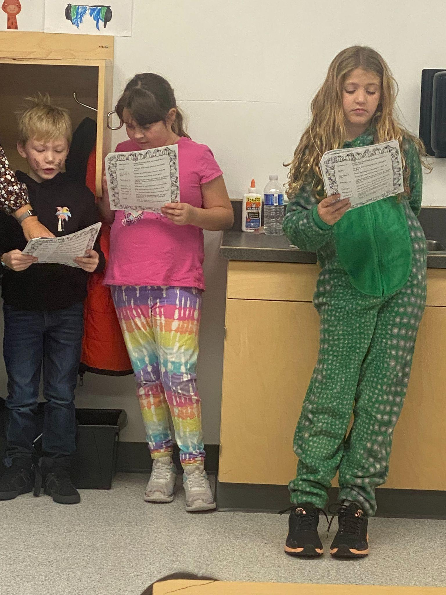
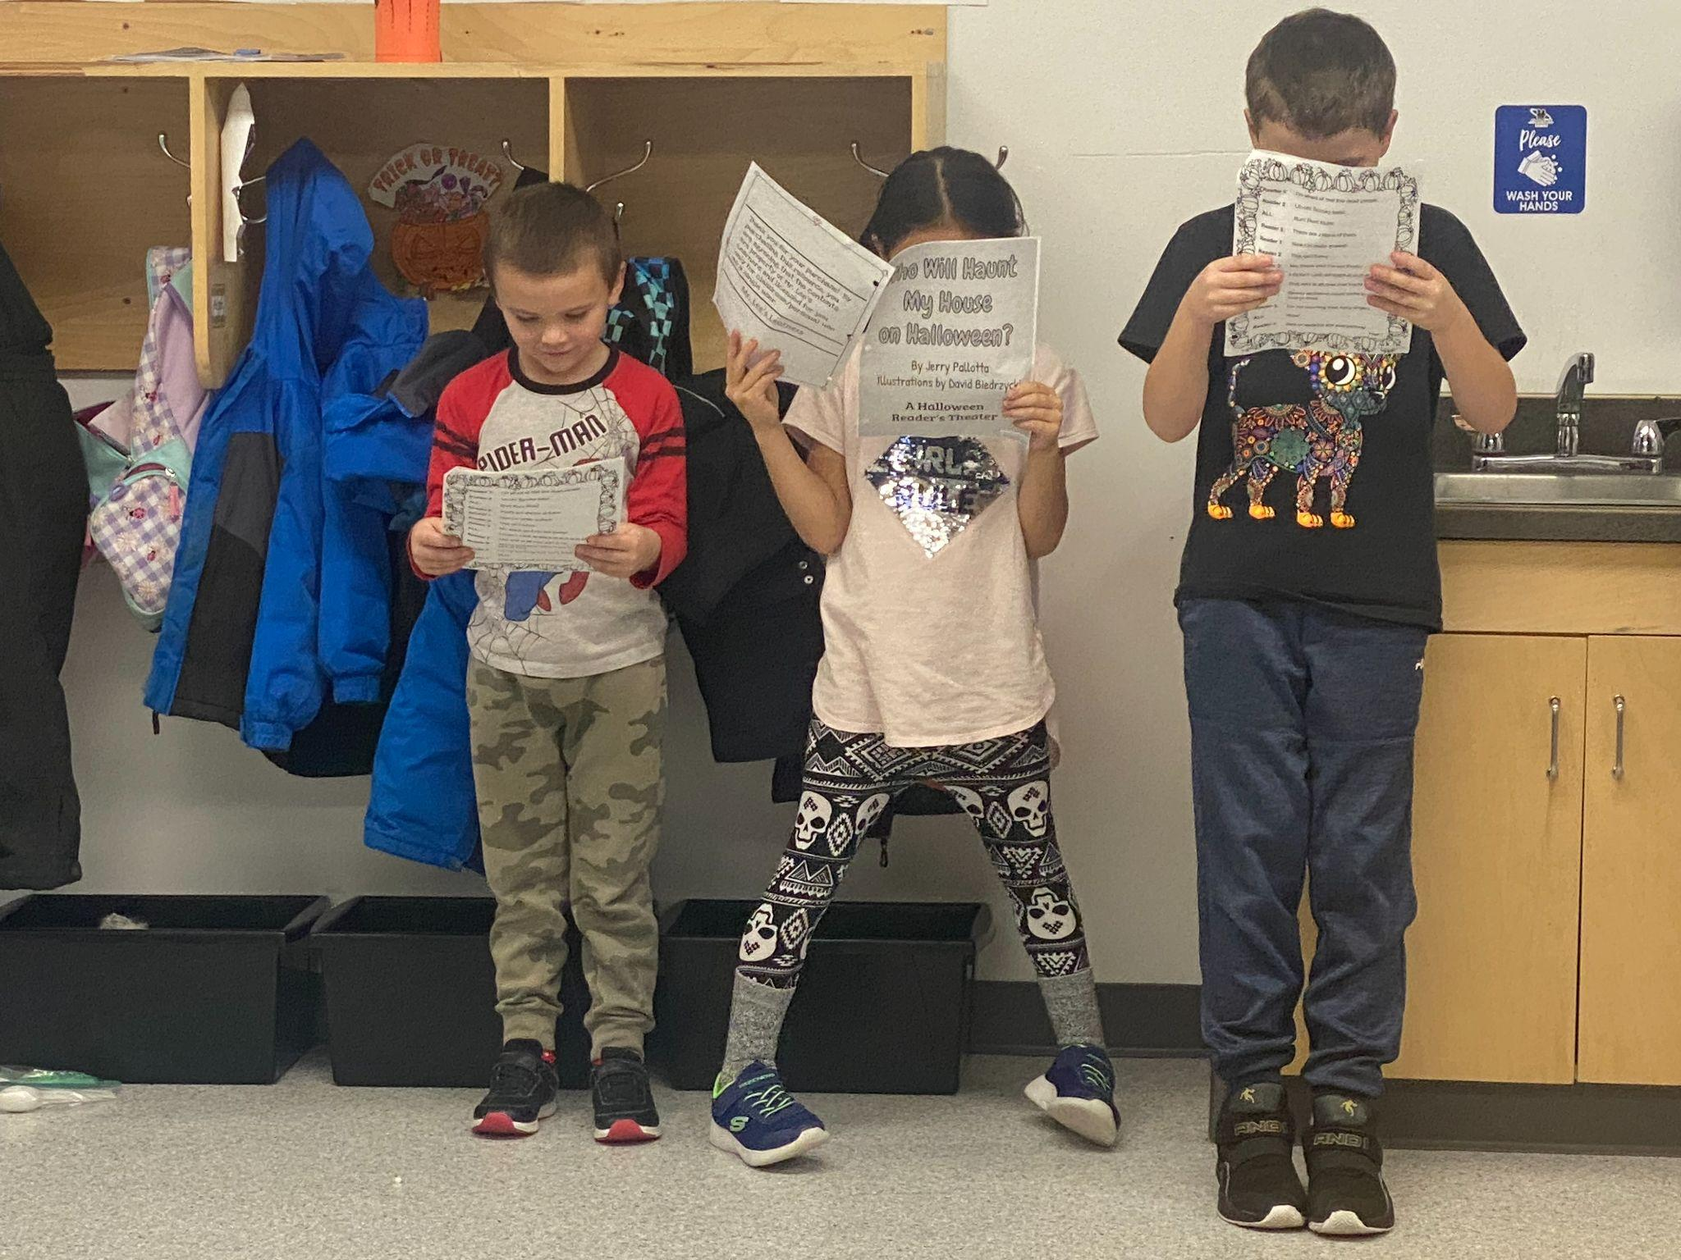
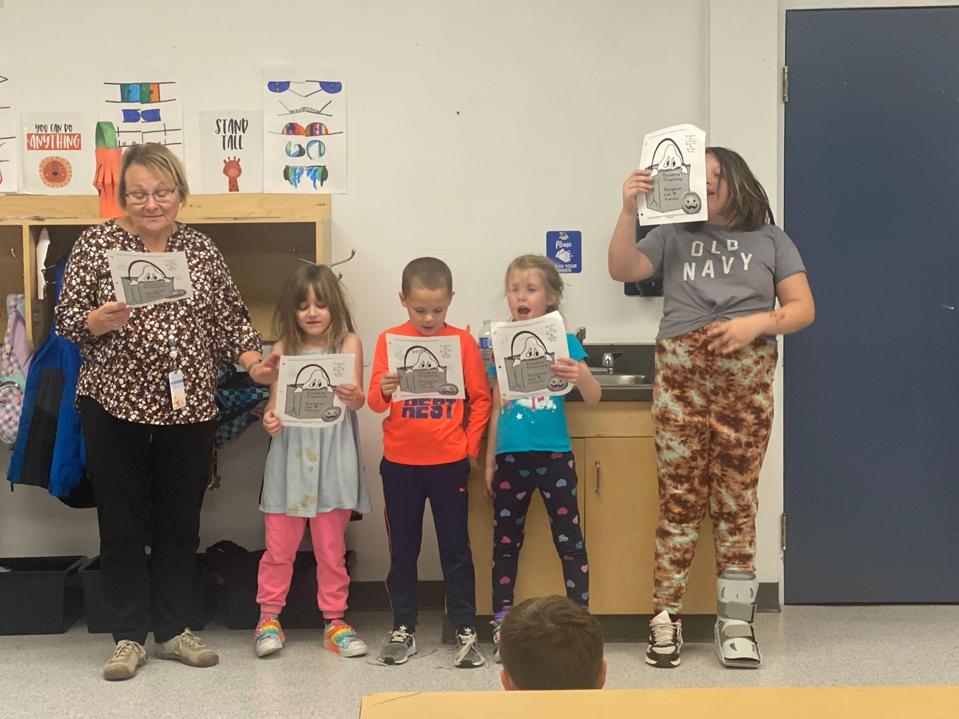
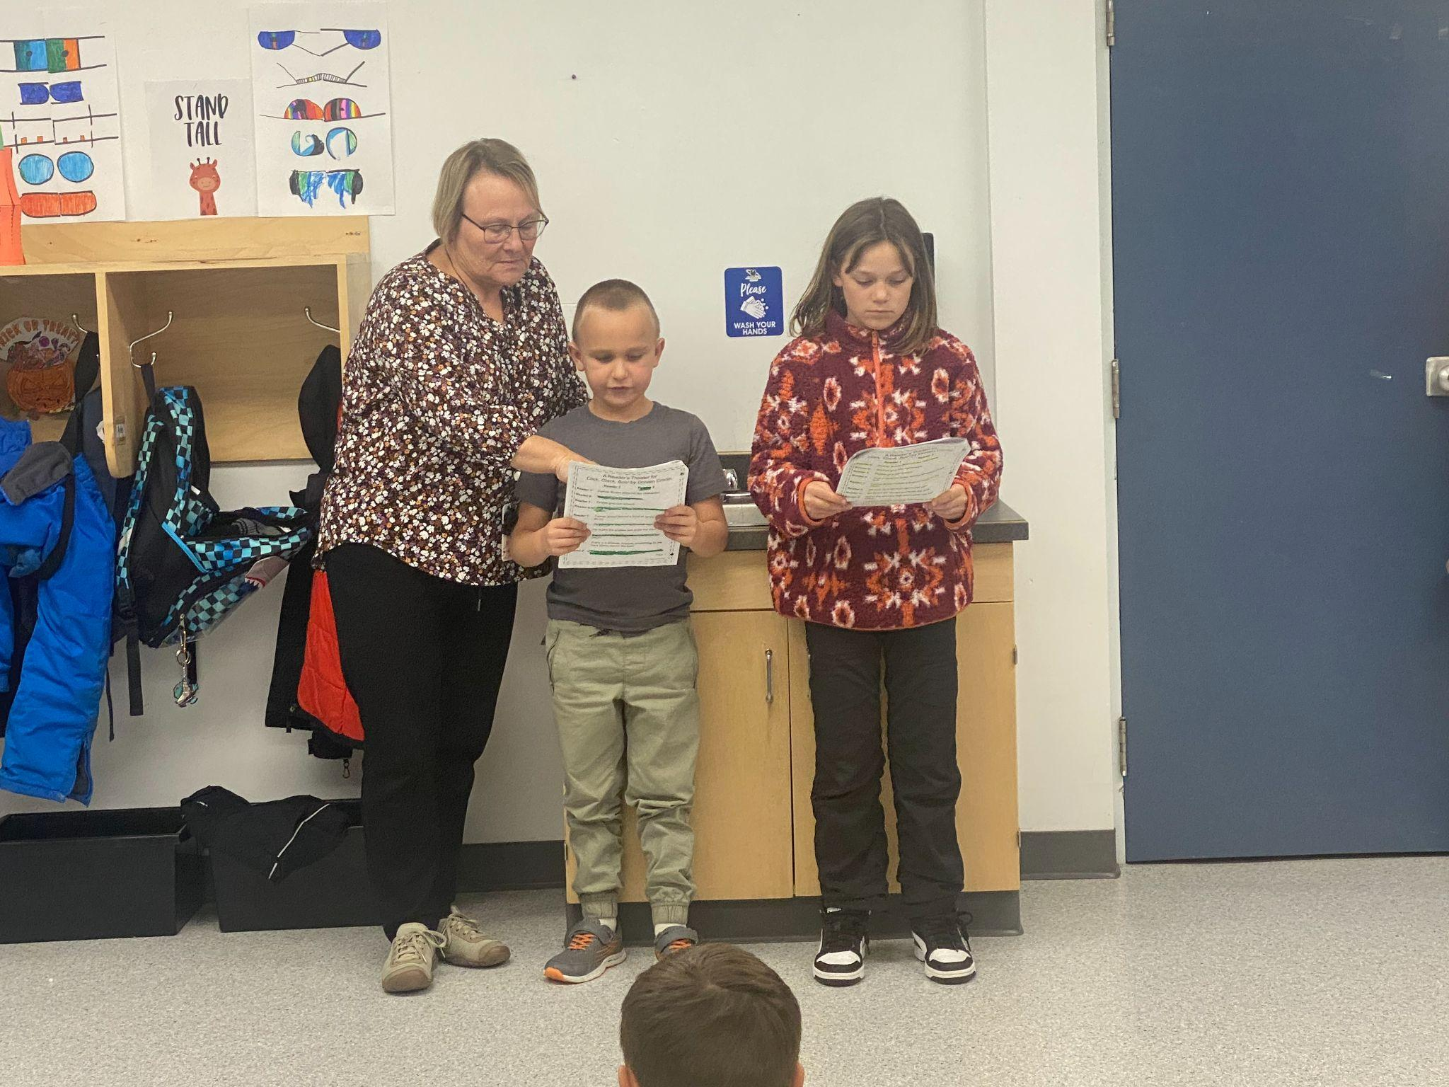
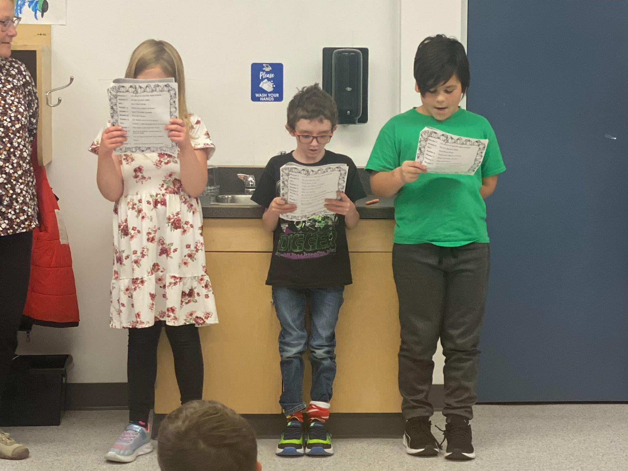
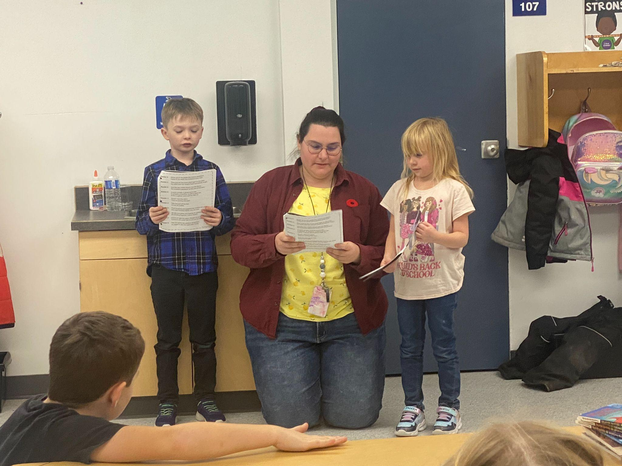
Literacy / Buddy Time

Slide 8
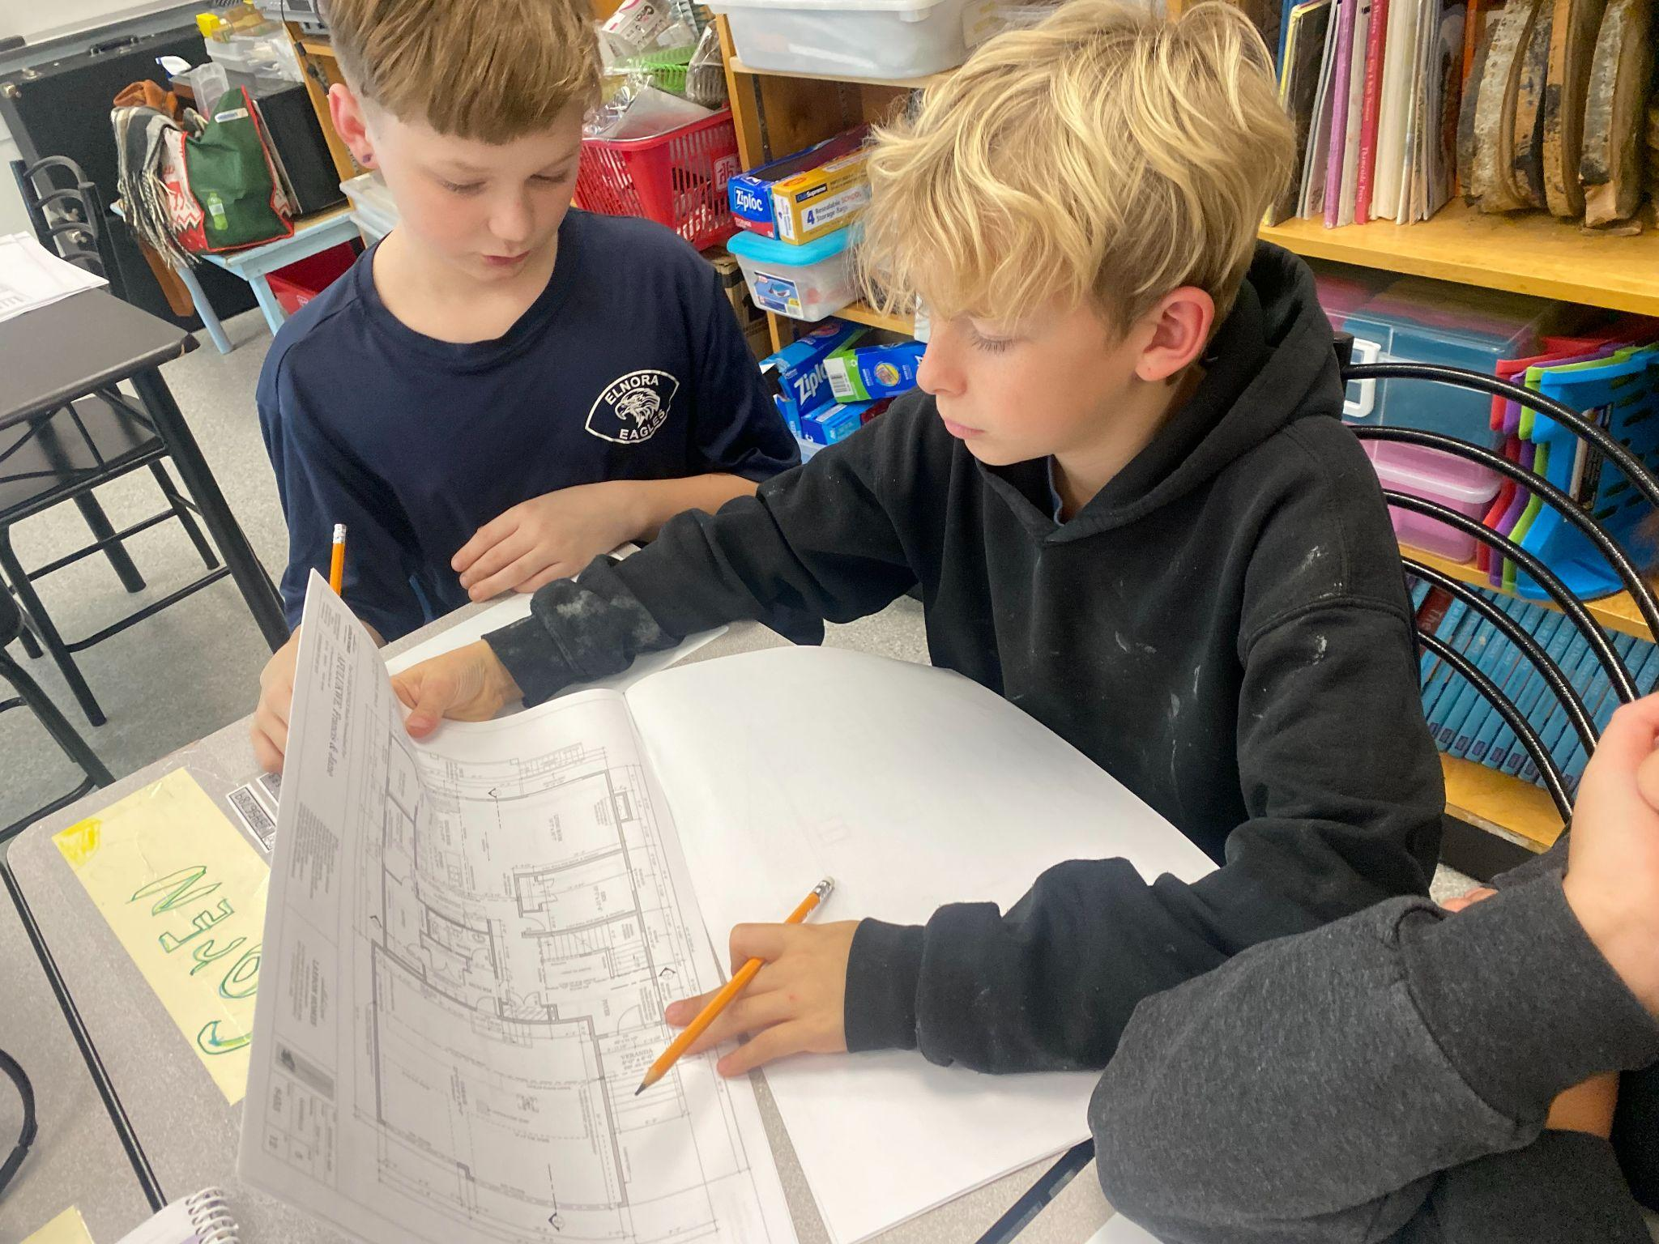
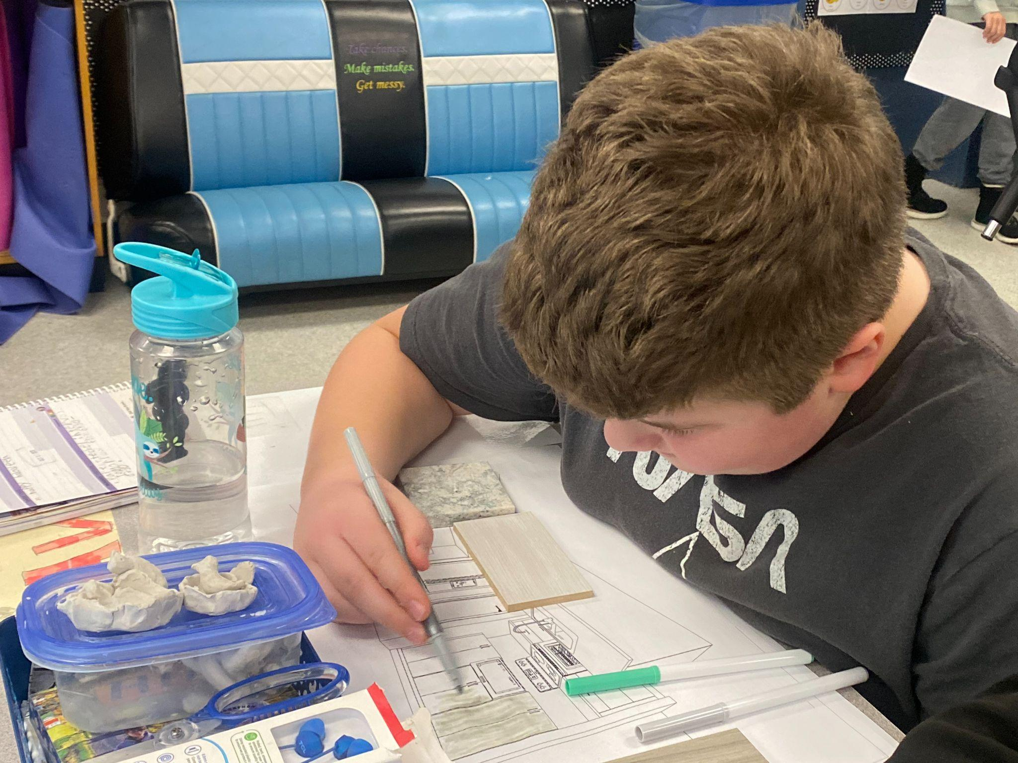
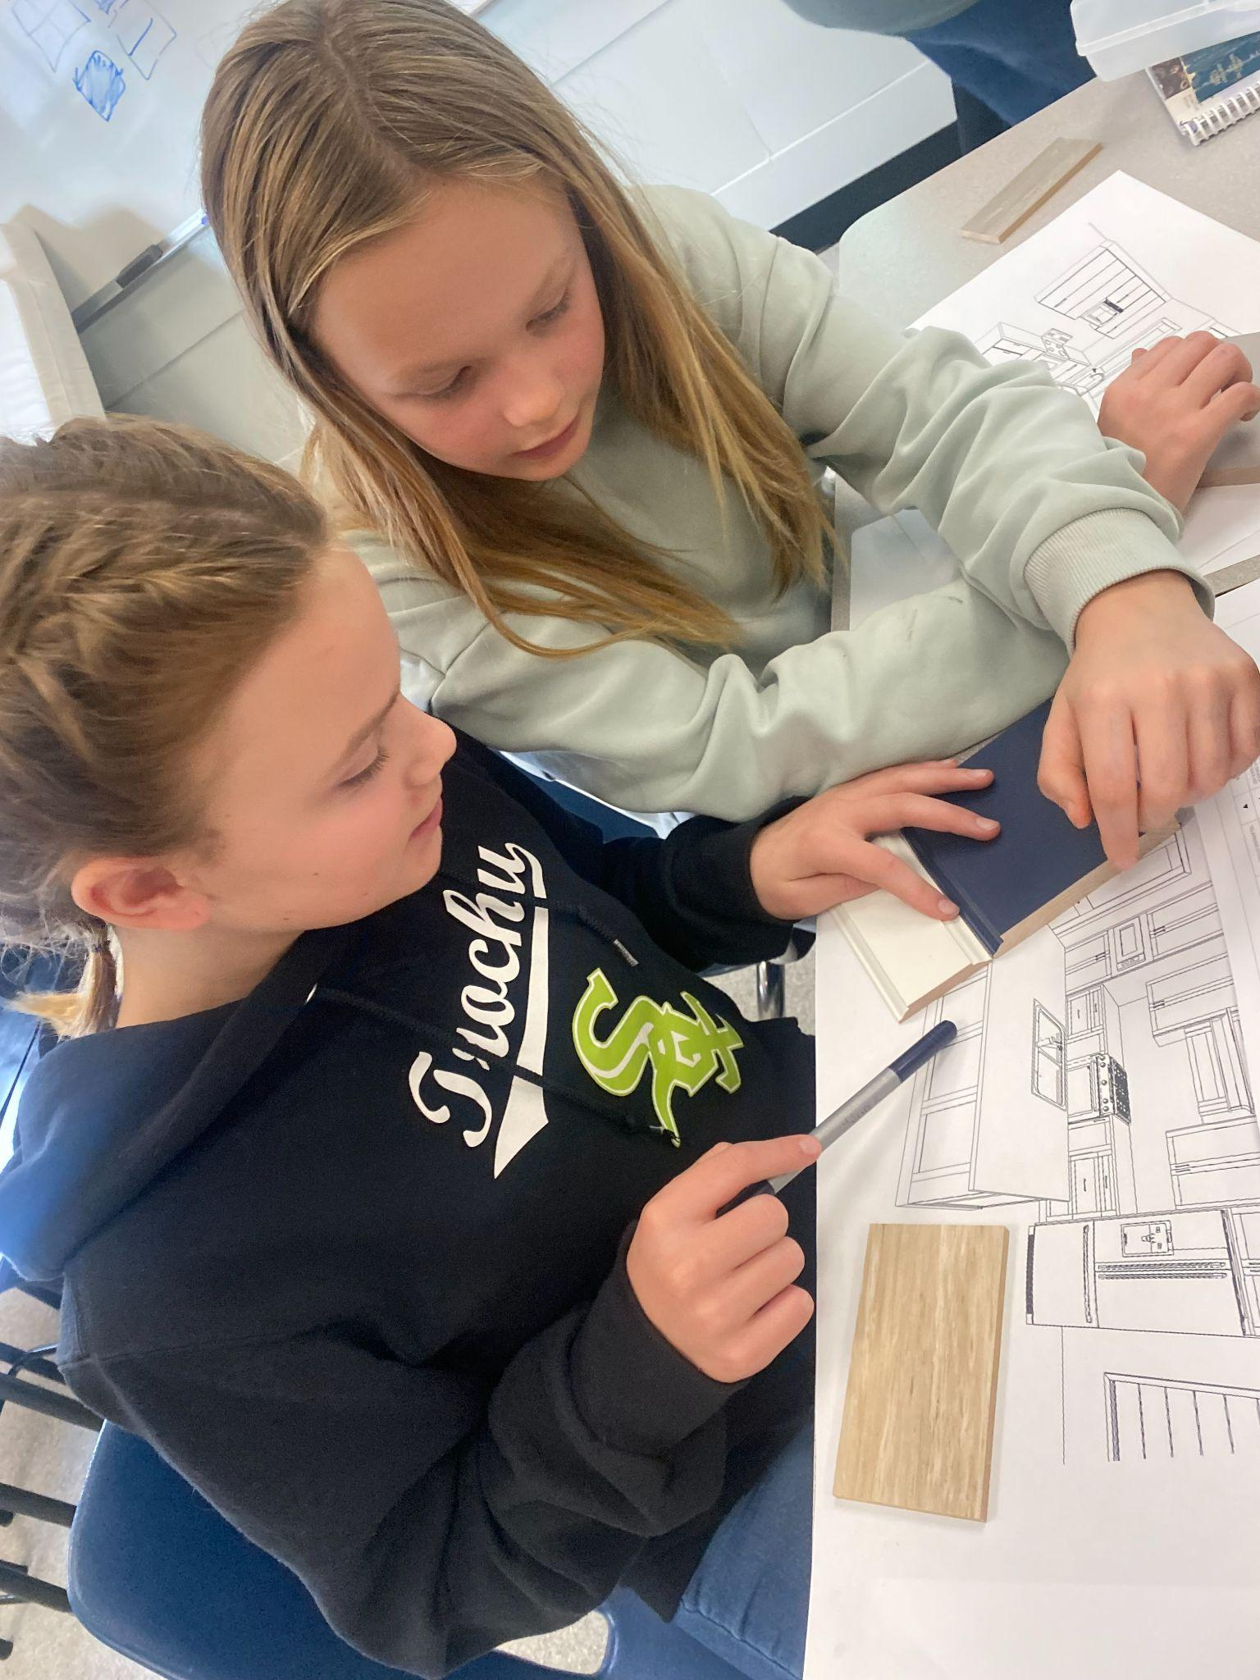
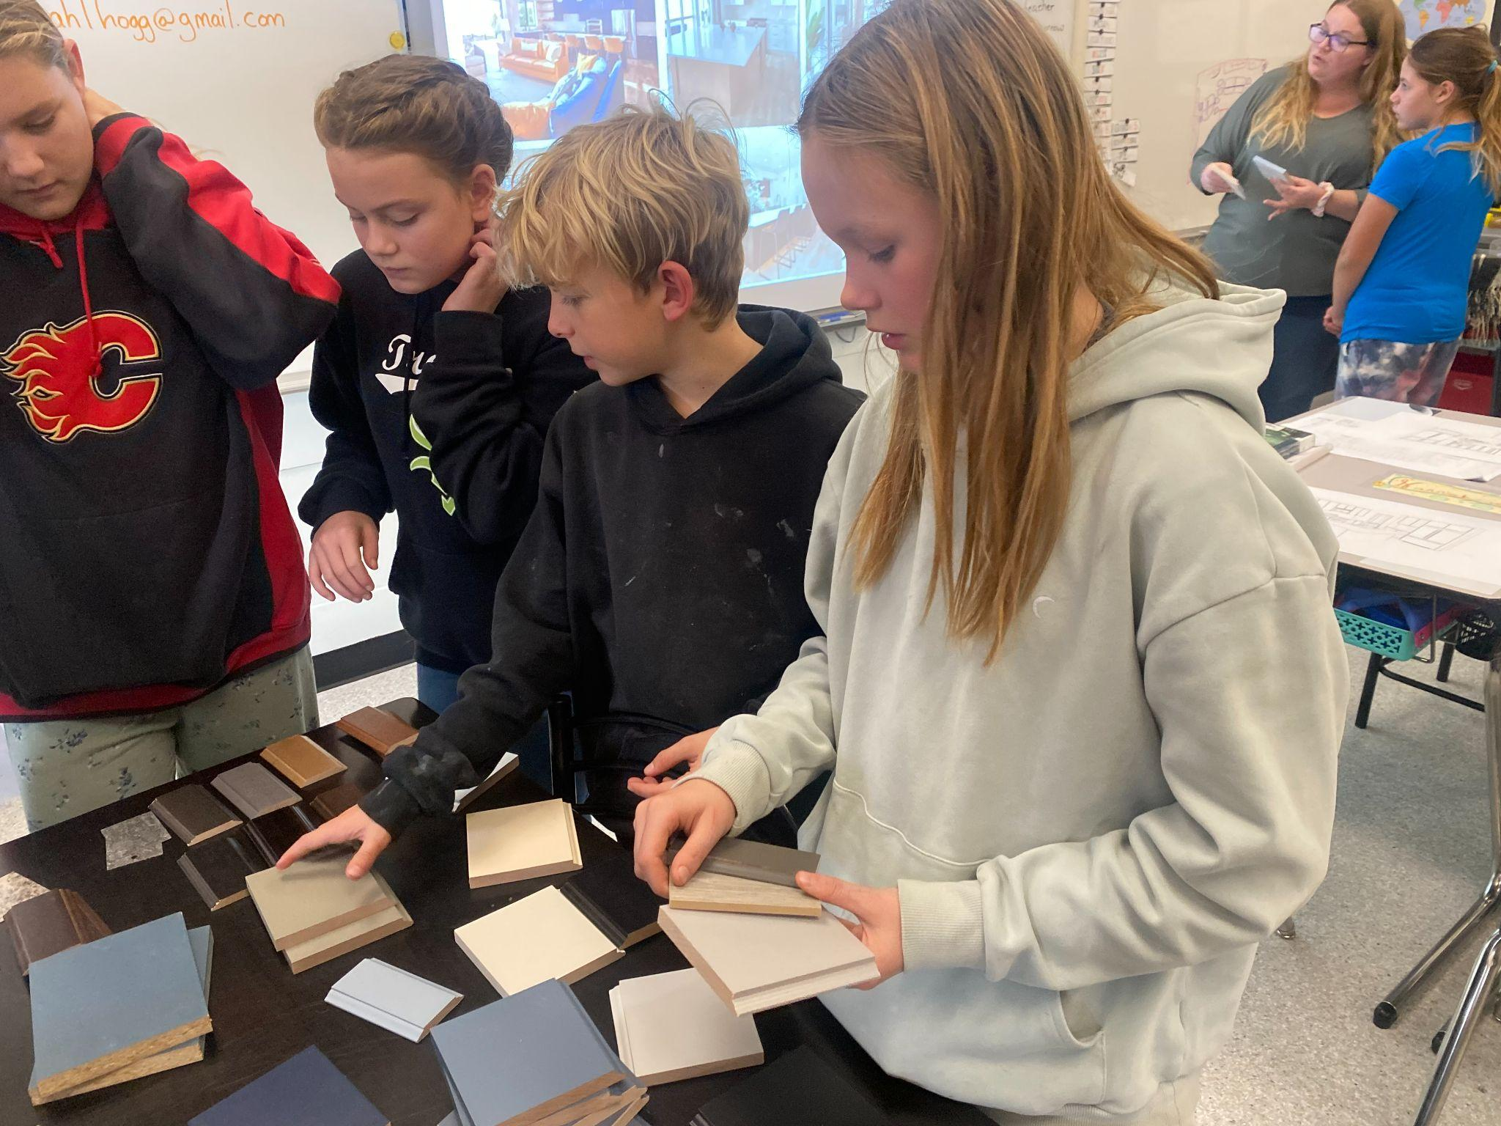
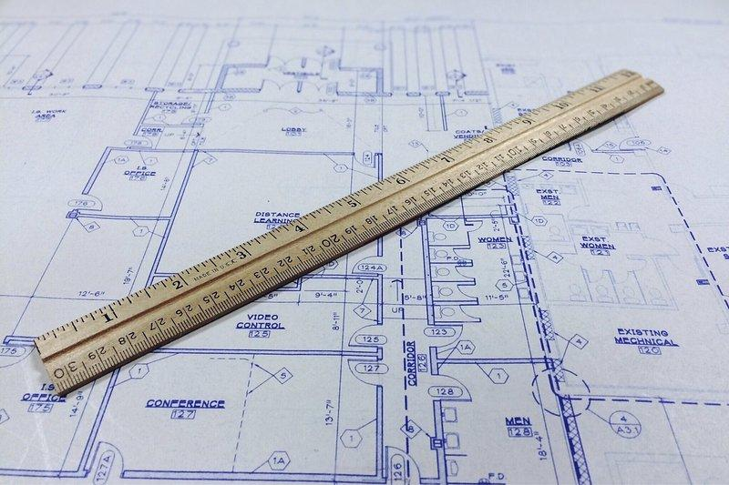
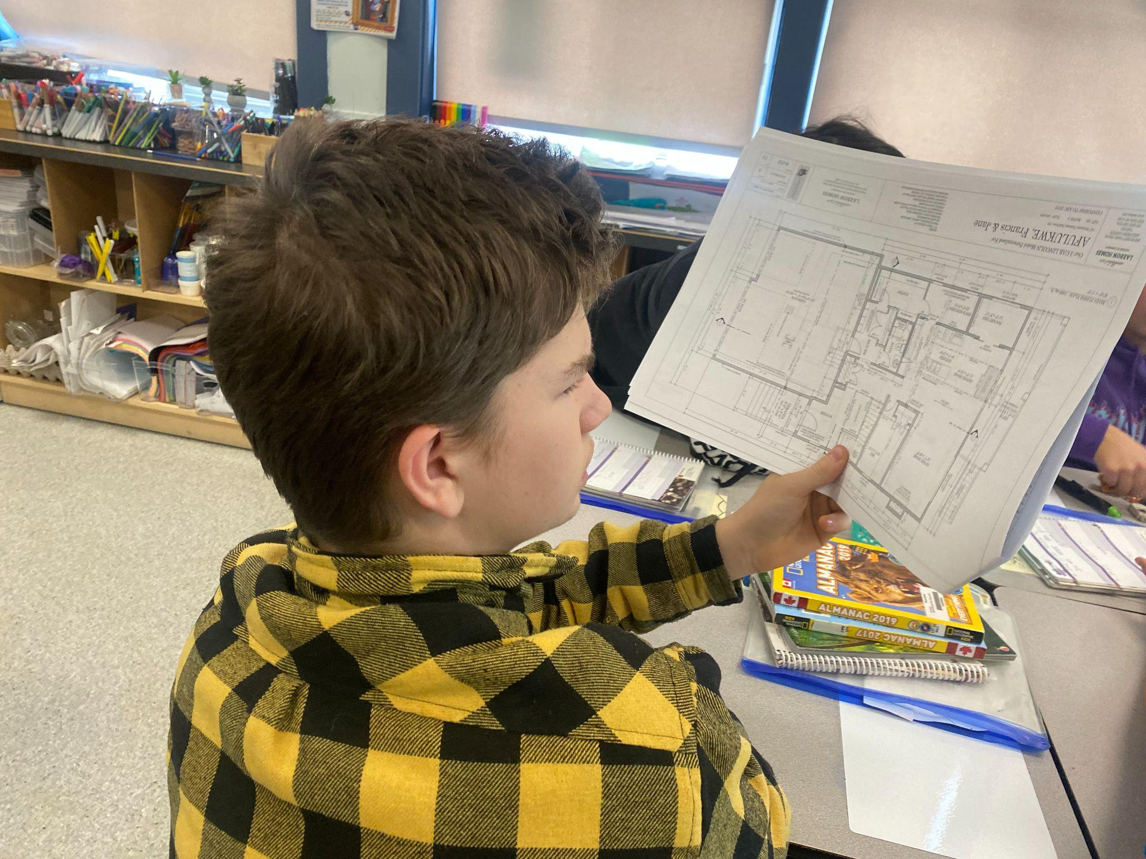
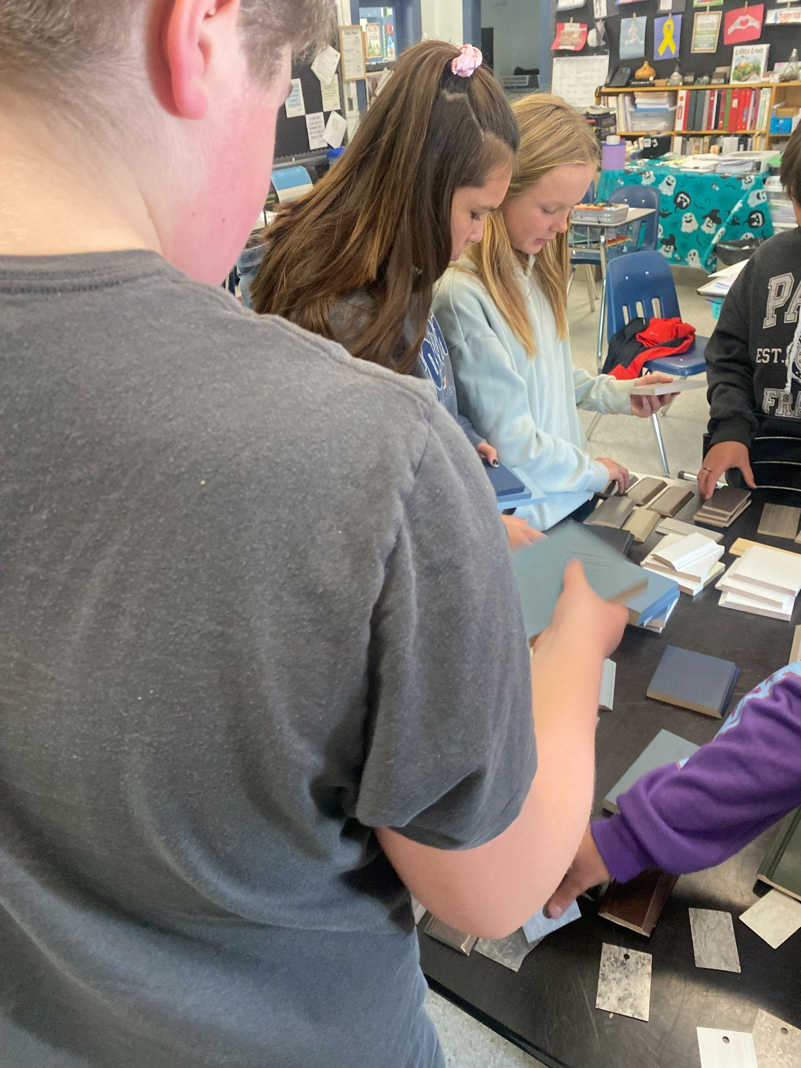
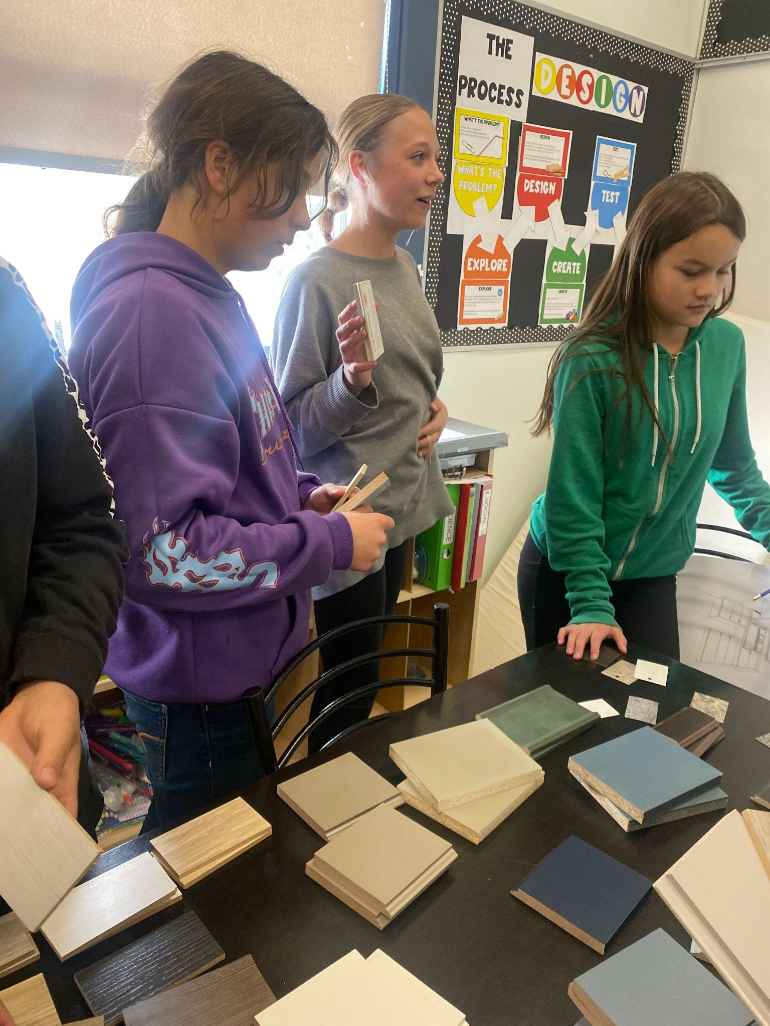
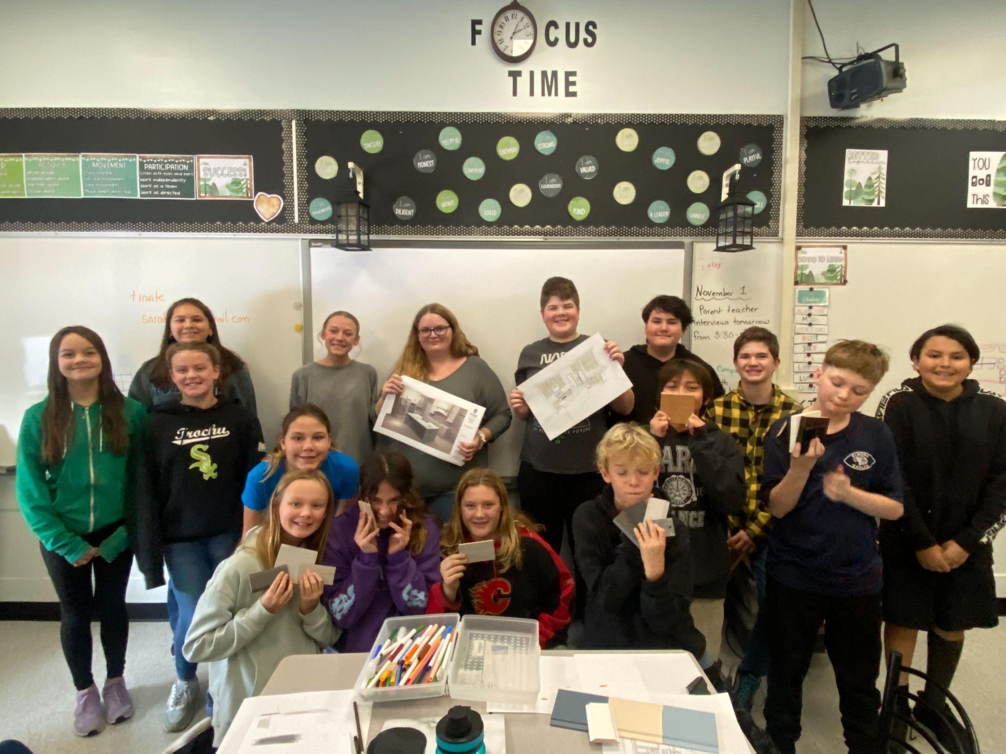
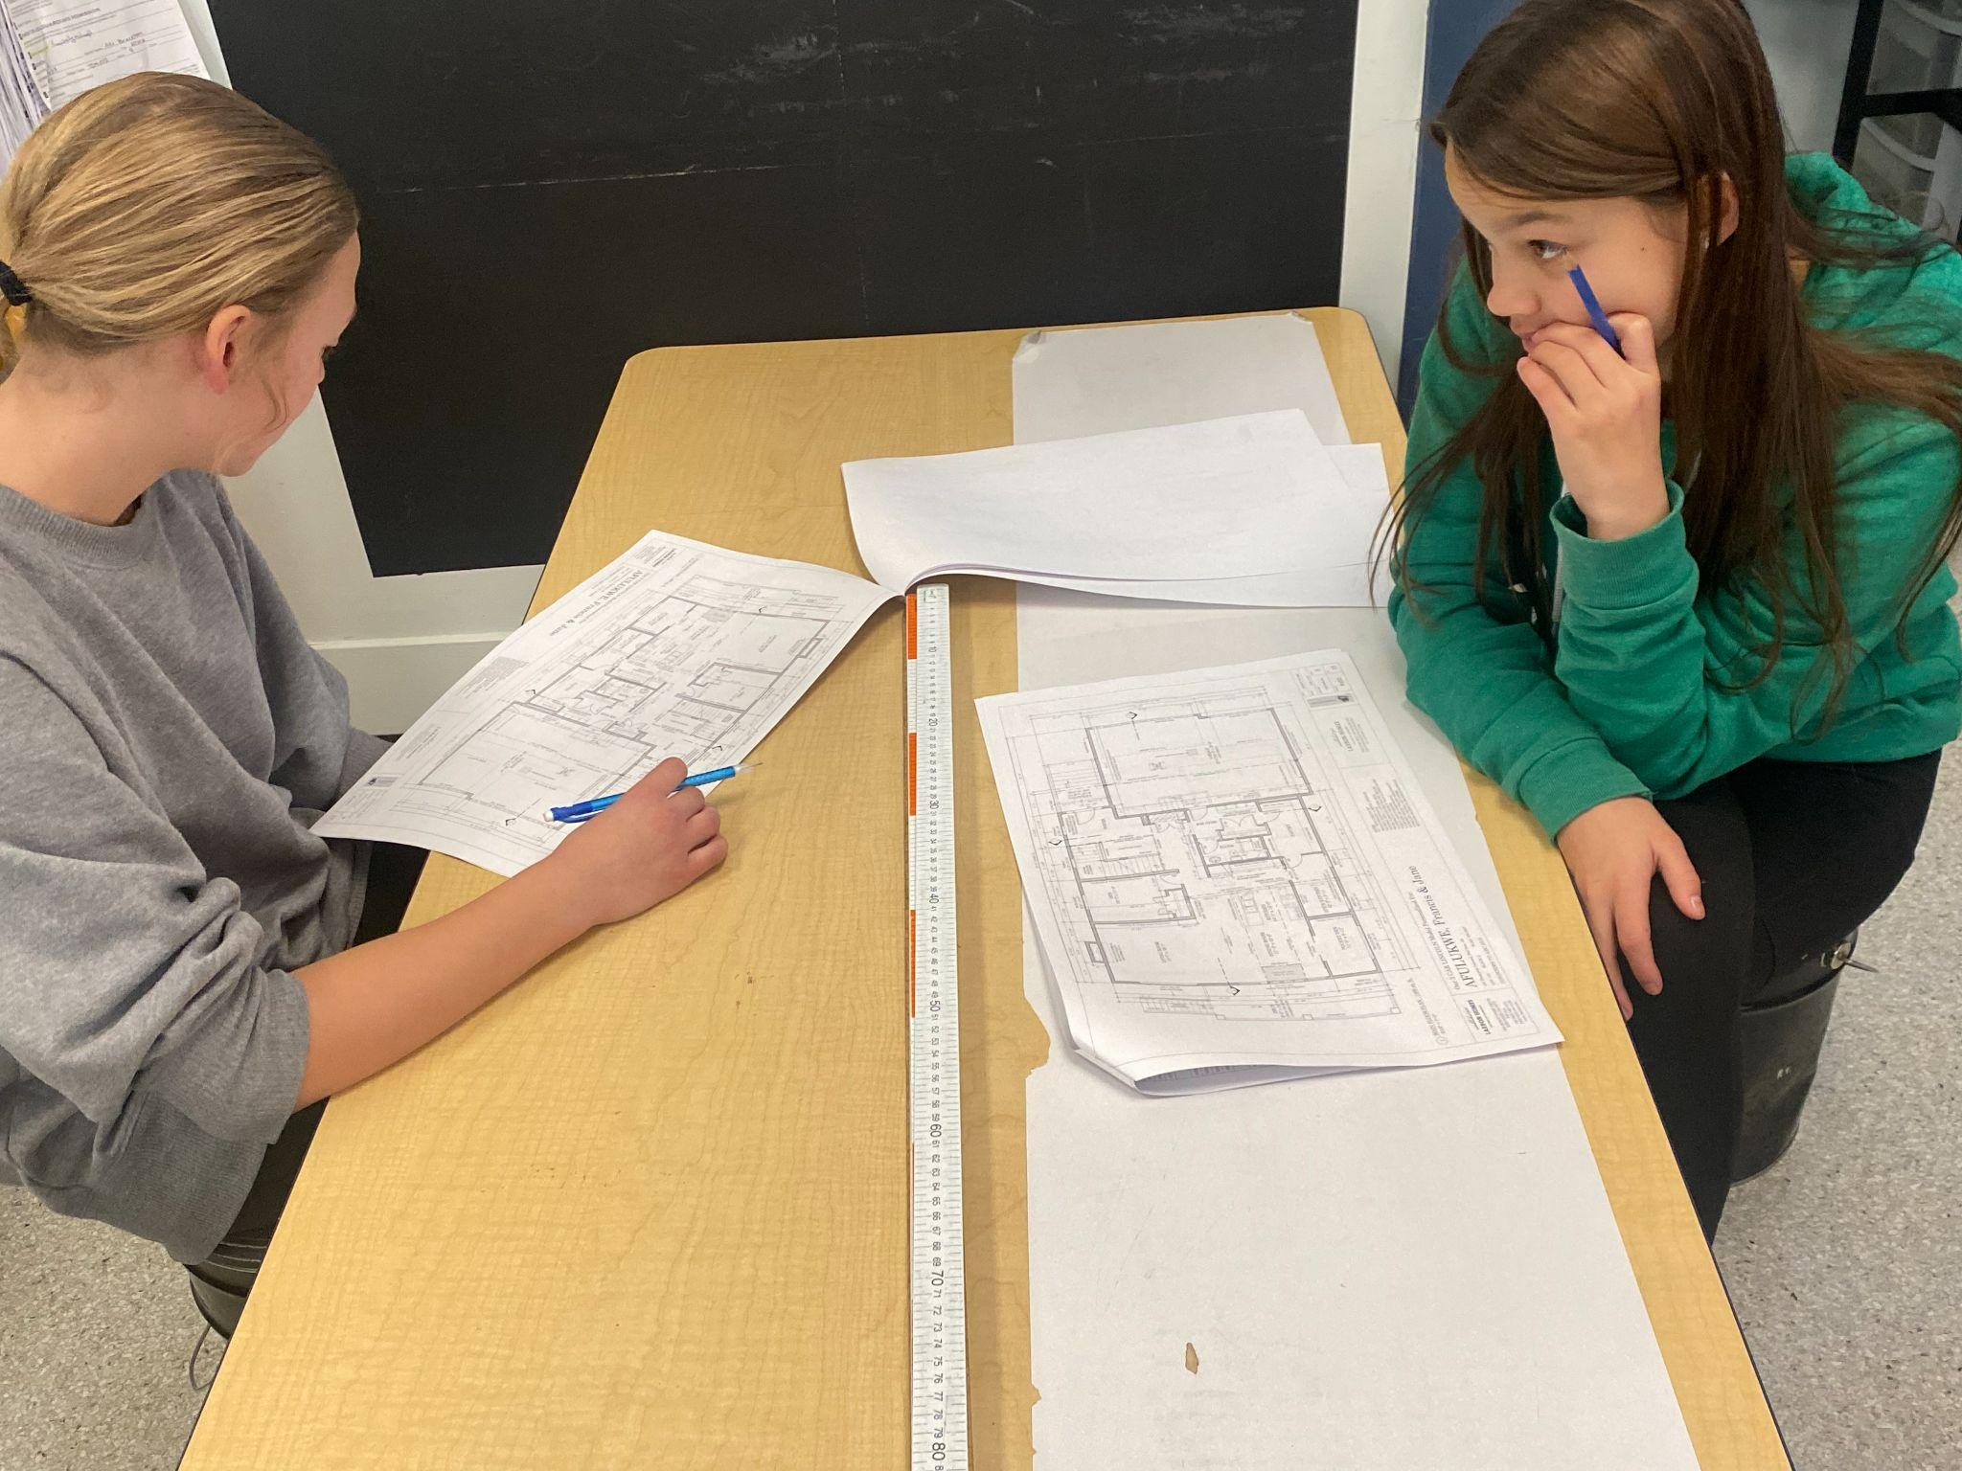
CTF OPTIONS CLASSES GRADES 6-8

Slide 9
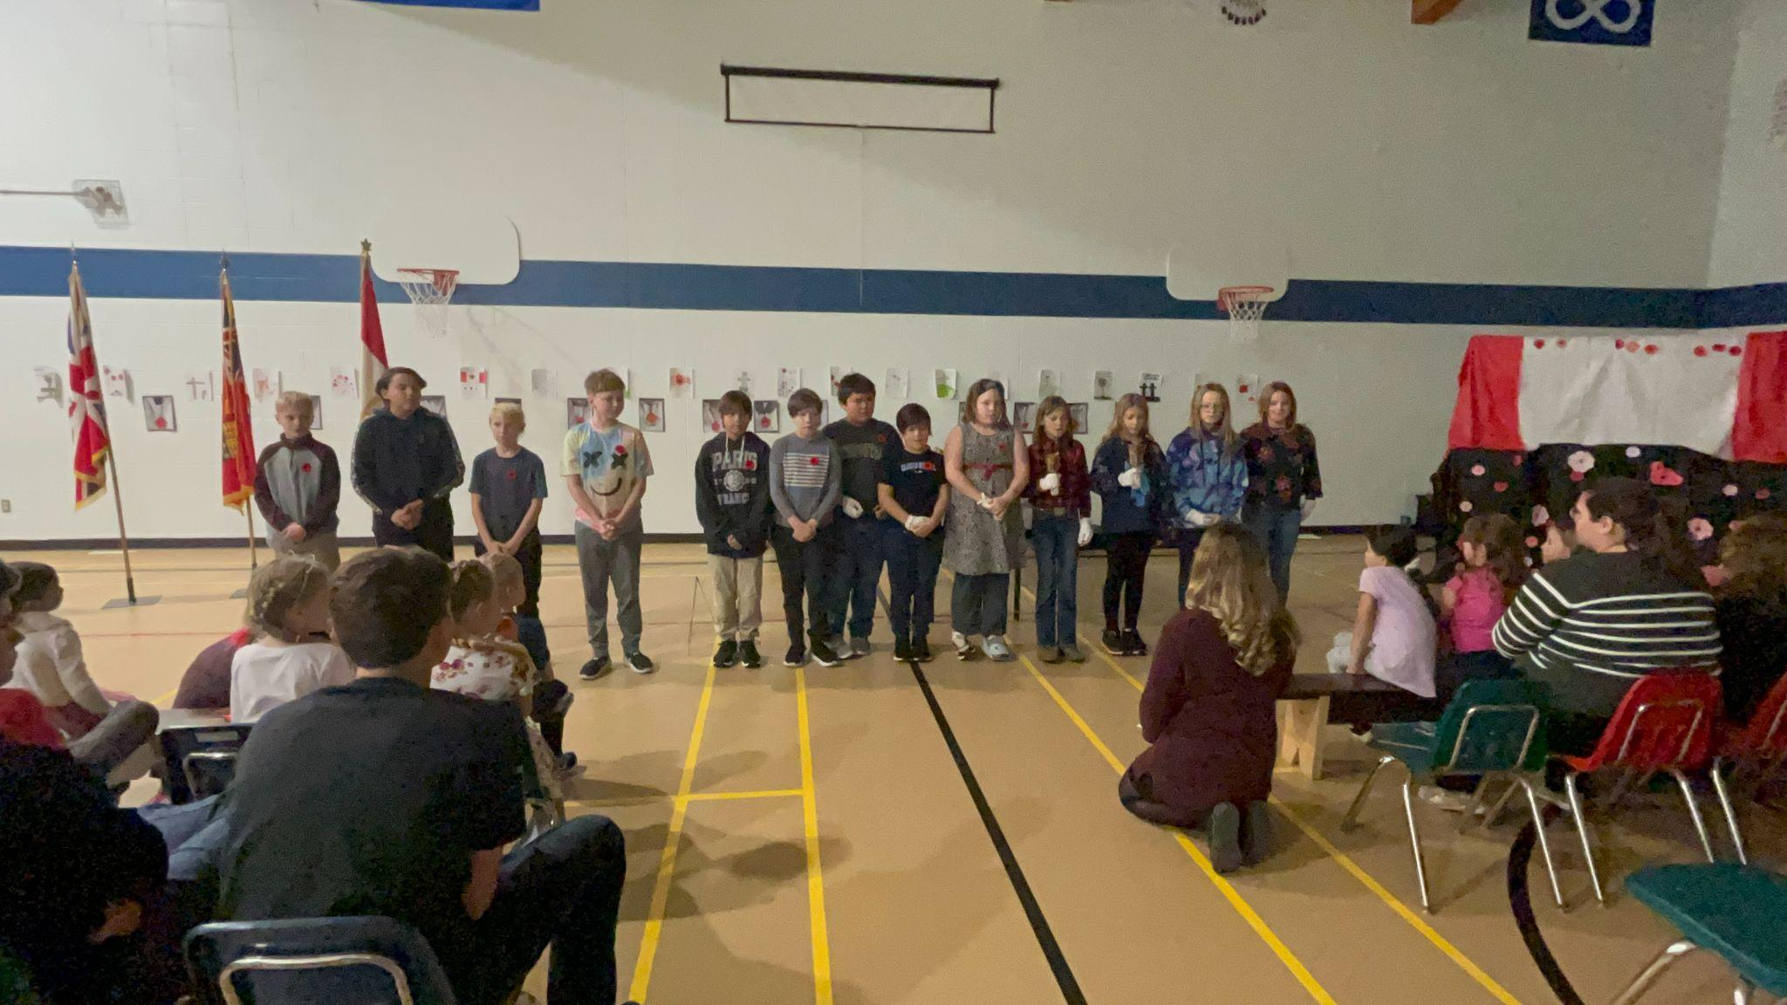
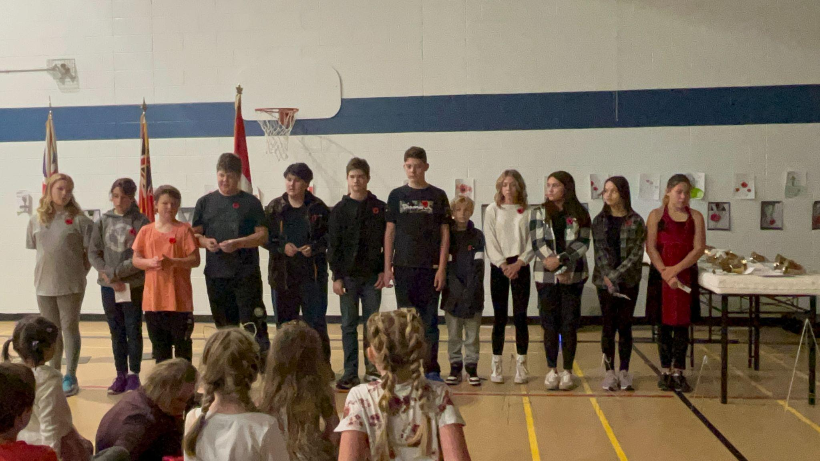
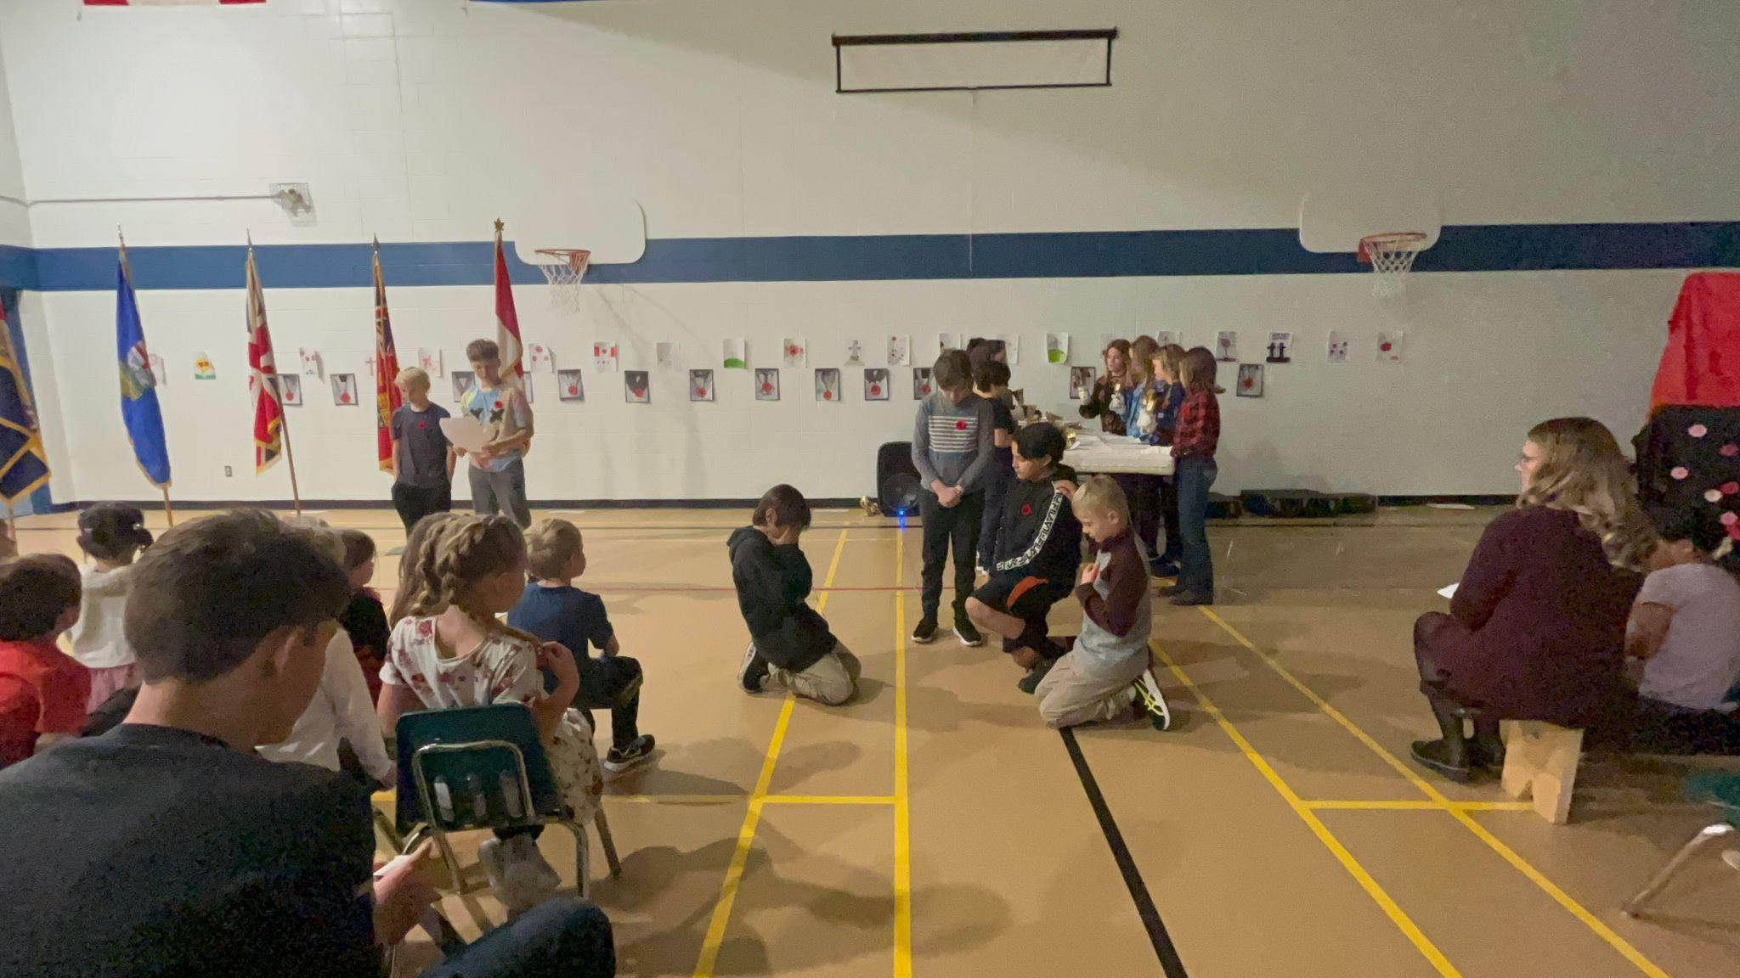
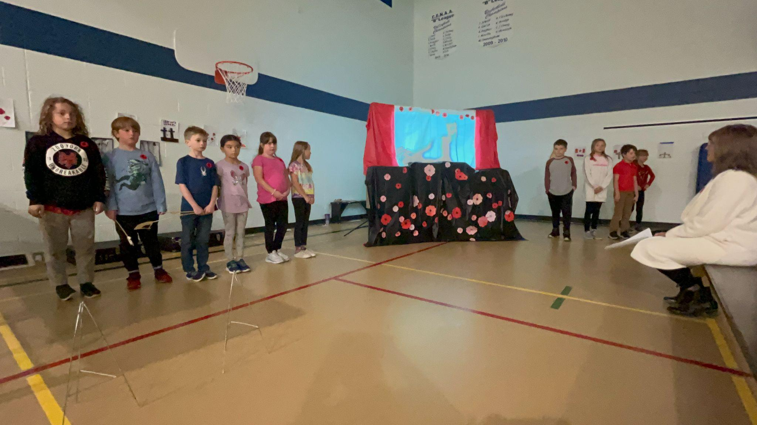
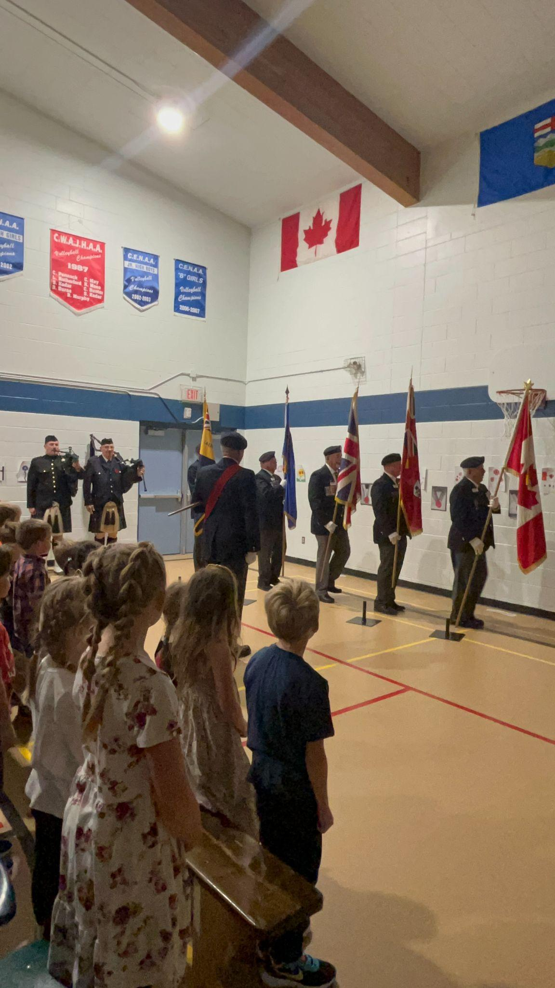
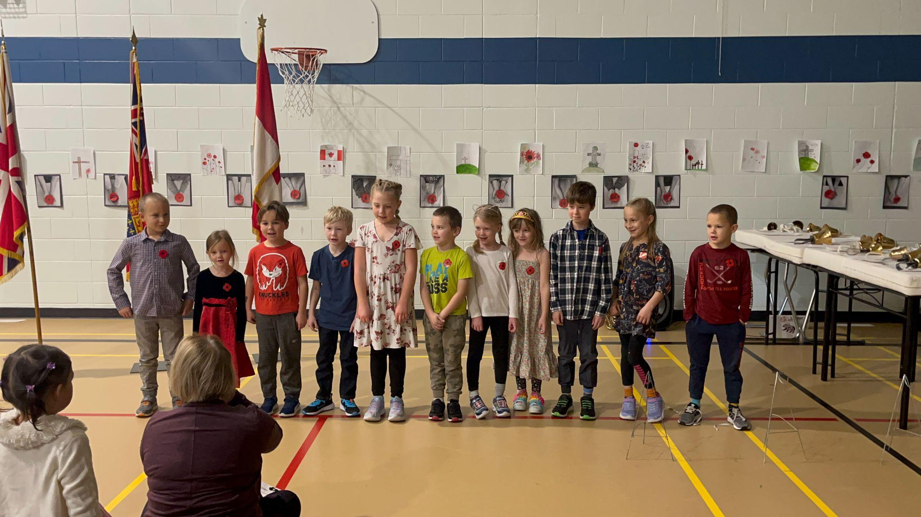
We Will Remember

